Slide 1
Emergency Preparedness
Dawna Daily, M.Ed.

Slide 2
Emergency Preparedness Education Series 2020 Down Syndrome Association for Families Presented by Dawna Daily, M.Ed.

Slide 4
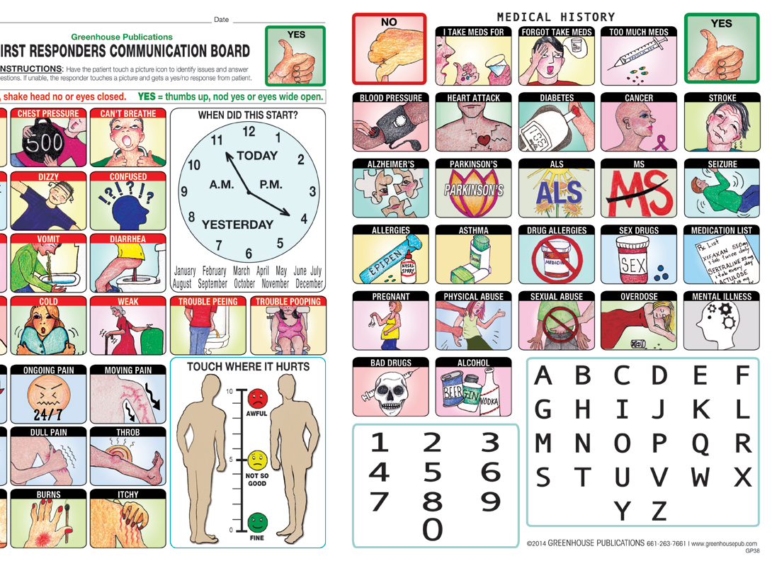
First Responder Cards
www.greenhousepub.com

Slide 5
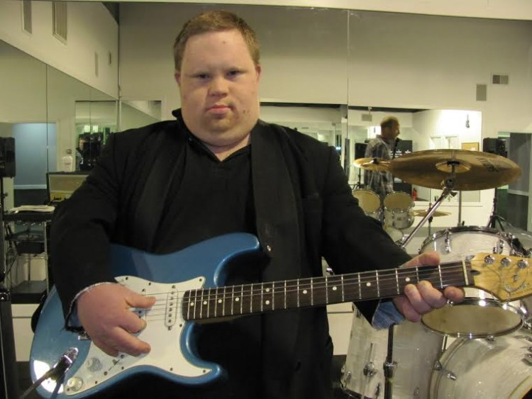
The Story of Ethan Saylor
https://youtu.be/jSlmkedujEQ
Take away: When justice professionals and individuals with disabilities are trained, encounters with law enforcement and the justice system can be more effective and safe.

Slide 6
Be Prepared! Build on skills!
-Having a plan and attending training can
Lessen anxiety among all parties
Allow all parties to feel more comfortable in every day interactions
Assist with helping individuals feel more prepared for emergency situations
HOW PREPARED IS YOUR FAMILY?

Slide 7
An Introduction to BE SAFE by Experience Autism
https://youtu.be/ZQx2Wj7T1gg

Slide 8
https://ifineedhelp.org/shop

Slide 10
Project Lifesaver (elopement) https://projectlifesaver.org/get-involved/enroll-a-loved-one/

Slide 11
Emergency Evacuations – Develop an EEP
https://activeshootertest.com/our-services/emergency-evacuation-for-persons-with-disabilities-plan-eepd/
Categories of Disability
Mobility Impairment • Hidden
Hearing Impairment • Obvious
Visual Impairment • Temporary
Speech Impairment • Emergent
Cognitive Impairment
View of Disability
Hidden
Hearing Impairment • Obvious
Visual Impairment • Temporary
Speech Impairment • Emergent

Slide 12
Non Emergency Safety Reporting
https://www.k12insight.com/Lets-Talk/embed.aspx?k=WY5Y3GLT@MDLT@DY1K6YLT@LDLT

Slide 13
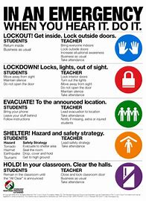
Standard Response Protocol
LPS Standard Response Protocol
https://home.lps.org/security/standard-response-protocols/

Slide 14
“Stranger Danger” Development of a code word
Consider developing a family emergency “code word” that is only used in cases of unusual circumstances.
Practice it often and ask your child to tell you what it is.
Let your child know if this person doesn’t know your code word you didn’t send them.
https://www.goodhousekeeping.com/life/parenting/news/a43654/family-code-words/#:~:text=Family%20code%20words%20are%20personalized%20and%20secret%20%22passwords%22,situations%2C%20or%20protect%20little%20ones%20from%20potential%20abductions.

Slide 15
Water Safety

Slide 16
Josh the Otter Water Safety https://joshtheotter.org/

Slide 17
Water Safety – Pinwheels for Aspen
http://www.pinwheelsforaspen.com/

Slide 18
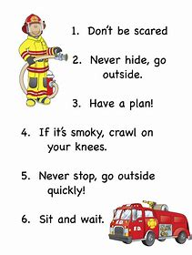
Fire Safety
https://www.bing.com/videos/search?q=fire+safety&docid=608027335905774451&mid=D77D47D9DB4D6455D721D77D47D9DB4D6455D721&view=detail&FORM=VIRE
https://www.lincoln.ne.gov/city/fire/index.htm

Slide 19
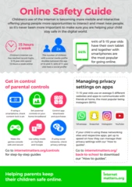
Safety Online
https://youtu.be/K3-wcM9gRrg
https://www.swgflstore.com/collections/resources?page=3

Slide 20
Home Safety
https://prevention1st.org/safe-at-home-a-next-step-for-adults-with-disabilities/
https://ablethrive.com/life-skills/home-safety-tips-people-disabilities
https://www.redcross.org/get-help/how-to-prepare-for-emergencies/disaster-safety-for-people-with-disabilities.html
https://crimedoctor.com/home-security-burglary-prevention/

Slide 21
Pandemic related safety
Home schooling in Nebraska
Exempt Schools under Rule 13 NDE
Exceptions for pandemic that let your child remain enrolled in “home school”
https://www.education.ne.gov/fos/exempt-schools/
LPS
https://home.lps.org/covid-19/2020-2021-pandemic-procedures/

Slide 22
Red Cross Emergency Preparedness
https://www.redcross.org/get-help/how-to-prepare-for-emergencies/types-of-emergencies/coronavirus-safety/preparing-for-disaster-during-covid-19.html
Download the App
Download the FREE Emergency App
Find our Emergency App in the Apple Store » or Google Play »

Slide 23
Managing Anxiety during the Pandemic
https://live.myvrspot.com/folder?v=fNDM0MmY2MzM3ZDc3ZWJmZmEyMGZmYjFlZDEzNTJmYmI

Slide 24
Safety – Social and Emotional Support
https://suicidepreventionlifeline.org/
https://lincolnne.mylnk.app/categories
https://home.lps.org/covid-19/social-and-emotional-supports/

Slide 25
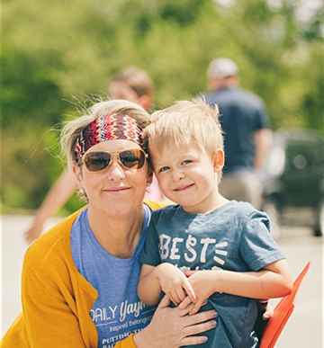
Contacts
All resources utilized in this presentation have links in the presentation for references used.
Contact me!
Dawna Daily, M.Ed.
(402) 206-3092
ddaily4@cox.net
Contact at the Down Syndrome Association for Families
director@dsafnebraska.org

