Slide 1
Communication Development in Children with Down Syndrome
Beth Dinneen, M.S., CCC-SLP
University of Nebraska-Lincoln
Department of Special Education and Communication Disorders
Instructor/Clinical Supervisor
bdinneen2@unl.edu, 402-472-7853

Slide 2
Terminology….
Speech- verbal output, motor process of producing voice, sounds, words
Language-symbolic code, rule-based, shared with others, expression and comprehension
Communication-active, reciprocal exchange between individuals. Sending and receiving of messages

Slide 3
Speech and language is a process of gradual development over many years
Speech and language follows a fairly predictable pattern of development
There is always variability in development
Many reasons why a child would show delays or differences in development of speech and/or language
  Down syndrome, Autism Spectrum Disorder, hearing loss, Cerebral Palsy, Traumatic Brain Injury, Idiopathic

Slide 4
Speech and Language Characteristics of Children with Down Syndrome
Generally, children with Ds meet communication milestones later-but there is much variation
Sensory, perceptual, physical and cognitive challenges can occur and can affect communication development – varies for each child
Identifying areas of challenge is important- provides you/your team with information on how to plan and provide support

Slide 5
Communication Milestones in Children with Down Syndrome
Communication Skill | Age
Smiling | By 12 months
Laughing | By 12 months
Cooing, vowel-like sounds | By 12 months
Babbling | By 12 months
Facial expressions, gestures, signs | 12-24 months
Imitates sounds, actions, syllables and occasional word | 12-24 months
Pointes to 3 body parts when asked | 13-25 months
Jargon-jabber with inflection | 12-30 months
Says or signs first word | 12-60 months (signs come earlier)
Points to pictures when named | 24-36 months
Initiates conversations-pointing, requesting | 24-36 months
Understands 50-100 words | 24-36 months
Uses 2-word phrases | 2-5 years

Slide 6
Possible Challenges
Sensory and Perceptual Skills
Sensory-see, hear, touch, taste smell: Perception-ability to give meaning to the sensory input
Hearing-typical way to learn language and learn how to perceive or understand what sounds mean
  majority of children with Ds have some degree of hearing loss
  Differing types of hearing loss-some temporary, some permanent
  Approx. 75% have significant hearing loss at some point
  50-70% experience otitis medial with effusion (middle ear inflammation with fluid)
  Degree and type of hearing loss greatly affects planning and supports
  Hearing is essential for speech and language development and academic development

Slide 7
Possible Challenges
Sensory and Perceptual Skills
Vision-children learn language by connecting label with a visual object. Important for children to be able to look at caregivers during communication exchanges.
  Many children with Ds have visual difficulties
  Approx. 50% have strabismus (muscle imbalance issues causing eye/s to turn inward or outward)
  Nearsightedness and farsightedness are common
  Visual-spatial processing is often a strength, and children with Ds often learn best from visual picture supports or models than from a verbal direction only

Slide 8
Possible Challenges
Sensory and Perceptual Skills
Touch-babies learn through tactile exploration using hands and mouth. Sensation/touch around mouth is especially important for speech development
Children with Ds may have difficulty with sensory awareness and difficulty processing sensations in their mouth
Can have reduced sensation to touch or may be overly sensitive to touch-can result in less practice exercising lips and tongue, less enjoyment, less use of mouth which can affect speech development

Slide 9
Possible Challenges
Cognitive Characteristics
Children with Ds have more difficulty learning due to intellectual difficulties present (great variation)
Much of language depends on cognitive abilities including reasoning, memory, understanding concepts
Generalization of newly learned skills from one situation to another can be difficult –may learn a new skill in a specific situation but has difficulty automatically generalizing it to others. Training and practice helps!!
Memory, abstract thinking, processing skills are all tied to cognition

Slide 10
Possible Challenges
Sensory and Perceptual Skills
Sensory Processing/Sensory Integration-learning speech and language (as with any skill) involves ability to simultaneously process and organize input from more than one sense. Ability to organize input from various senses and apply them to everyday life
Children with Ds may have difficulty with this-especially learning to pay attention, listen, look at respond. May be overwhelmed with many sensations around them
May exhibit behaviors such as hyperactivity, impulsiveness or limited reactions (both ends of the continuum)-can be signs of sensory processing difficulties
Get your Occupational Therapist on board!!

Slide 11
Possible Challenges
Physical Differences
Hypotonia-low tone
Difficulty moving lips, tongue and jaw independent of each other (dissociation)
Small mouth in relation to tongue size
Tendency to breathe through mouth due to colds, allergies, colds, tonsils
High, narrow palate which can limit tongue movements
All of these can affect articulation of sounds, how fluent speech is, quality of voice, and sequencing of sounds and intelligibility of speech

Slide 12
Possible Challenges
Asynchronous Development of Communication Skills
Receptive-Expressive Gap-most all children with Ds can understand language more easily than they can express it.
  This can lead to incorrect assumptions!
  We must work to provide alternative supports to children while their expressive speech/language skills are developing! Finding a way to help them communicate is of utmost importance
Vocabulary is often a relative strength
Learning rules of grammar is difficult and often a relative weakness-often hear short, agrammatical sentence (“go swim pool” rather than “let’s go swimming at the pool”)
Pragmatics or the social use of language is often a relative strength-verbal and non-verbal

Slide 13
Communication Disorders in Children with Down Syndrome
Once young children develop basic speech and language skills-development continues in a number of areas
Semantics or Meaning
Receptive vocabulary is larger than their expressive vocabulary
Vocabulary skills appear to be one of the strongest areas of language for children with Ds
Children begin to acquire receptive and expressive vocabulary at a young age and can continue through adulthood.
New experiences, conversations, reading and travel all help

Slide 14
Communication Disorders in Children with Down Syndrome
Morphology and Syntax
Verb tense endings, plurals, possessives, prefixes, suffixes, grammar, sentence word order
Children with Ds have difficulties in these areas
Hearing can affect this as many word endings are said softly or unclearly
Concepts can be abstract and difficult to learn (“ed” means past tense)
Children with Ds may learn grammar rules in the same order as children without Ds, but at a slower rate
Sentence word order may be difficult-this requires sequential learning
Overall, semantics (vocabulary) is easier than morphology and syntax

Slide 15
Communication Disorders in Children with Down Syndrome
Pragmatics (Social Aspects of Communication)
Little research done in this area as it relates to children with Ds
Overall, children with Ds interact very well socially
Can communicate with others even before they can use speech with facial expressions, gestures, sign language, pointing
Nonverbal social interaction skills are usually a strength
Children learn these skills through observation, but children with Ds will often need these skills directly taught, especially higher-level skills
Children with Ds typically WANT to communicate with others, but we may need to teach them HOW to use their skills in certain situations

Slide 16
Communication Disorders in Children with Down Syndrome
Speech Intelligibility
Safe to say that all children with Ds have some degree of speech intelligibility issues-varies greatly
Many contributing factors and many causes and many ways to treat
Need to consider:
  Anatomical differences
  Physiological differences (low tone, hearing issues etc.)
  Tongue thrust
  Hearing loss
  Neurological functioning
Appropriate treatment depends on cause of intelligibility issues

Slide 17
Intelligibility of Speech
Types of Speech Disorders
Articulation Disorder -working on individual sounds like "r" or "l". Based on developmental norms of sound development
Childhood Apraxia of Speech- motor planning problem; muscles work but brain cannot put the plan in place for correct sequence of sounds
Dysarthria- muscles don’t work properly due to gaps in neurological development. Often will also have trouble with chewing and swallowing
Phonological Processes-patterns or rules children use to simplify speech. Problematic when they don’t grow out of them or when intelligibility is severely affected

Slide 18
Intelligibility of Speech
Other Factors That Can Affect Intelligibility:
Rate
Volume
Voice quality (hoarse, hypernasal, hyponasal)
Loudness
Pitch
Fluency
Prosody/Intonation

Slide 19
Communication Disorders in Children with Down Syndrome
Dual Diagnosis
Most children with Ds are delayed in speech and language skills, but they usually find other ways to communicate wants and needs and seek out attention from others
If a child with Ds has speech and language delays and does not find alternate ways to interact or communicate with others, may need to pursue further evaluation
A change in development-withdrawing or loss of skills also warrants further evaluation
Hearing loss, seizure disorders, reactive attachment disorder, autism spectrum disorders need to be ruled out
Significant delays in speech and language does not mean a child has autism!
  Look for maintained eye contact, taking turns, seeking engagement and social interactions with others in his environment

Slide 20
Not being able to speak is NOT the same as not having anything to say

Slide 21
What can we do to support communication?

Slide 22
Alternative and Augmentative Communication (AAC)
Any means of communication other than verbal speech BUT we use and encourage whatever verbal speech the child has!
Sign language, gestures, pictures, picture books, switches/buttons that record a voice message, iPad with speaking applications, dedicated communication devices
Multi-modal-we use any and all forms of communication.
  Total Communication-use of gestures/signs combined with speech
Temporary or permanent, use and need will change over time
End goal is always verbal speech-this will vary depending on individual child

Slide 23
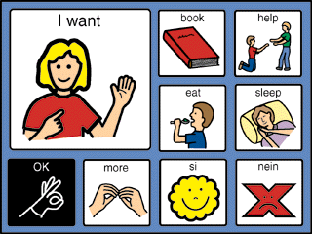
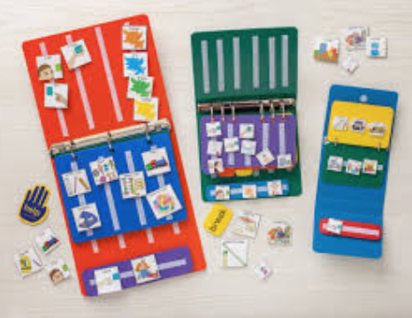
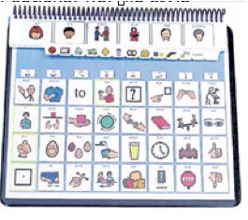
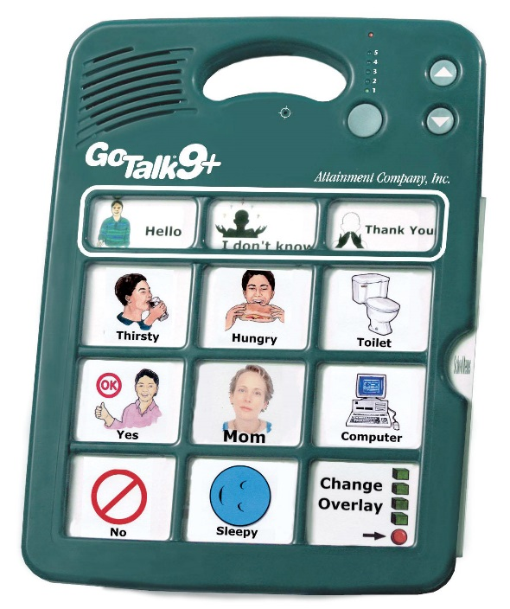
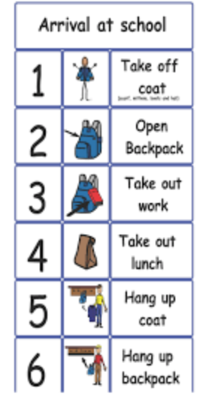
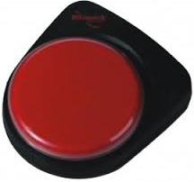

PECS
Low-Tech/No-Tech

Slide 24
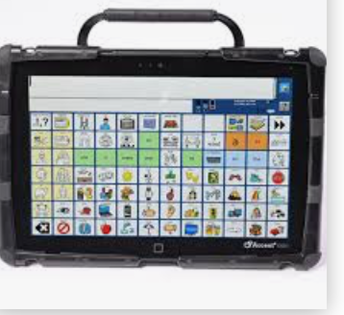
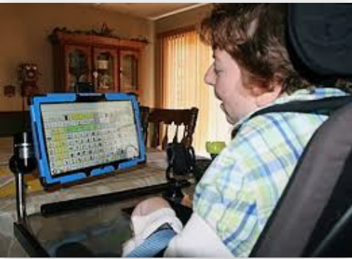
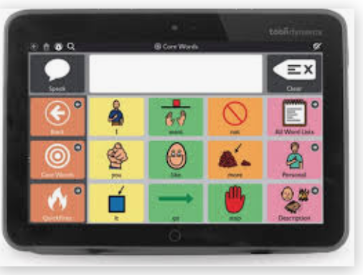
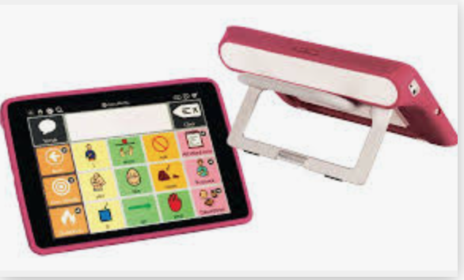
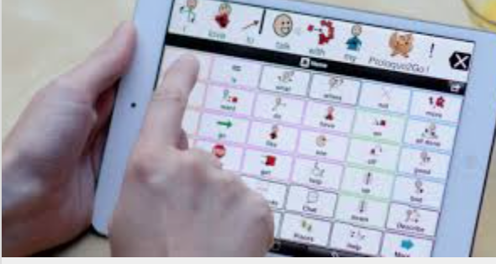
High-Tech
The iPad revolution!!

Slide 25
References
https://www.youtube.com/watch?v=CFi_vMlMYCg iPad
https://www.youtube.com/watch?v=wldth0nZ5VA pecs

Slide 26
Common Myths related to AAC
Remember-this refers to ALL forms of communication-gestures, sign, pictures, technology
Use of AAC will keep the individual from talking
Introduction of AAC means we have given up on speech
Child will not learn or use speech and will take the easy way out and use AAC
Child must possess a specific set of “prerequisites” before they can use AAC
Child needs to have ”normal” intelligence to use AAC
High-tech aids are more effective than low-tech/no-tech aids

Slide 27
How can parents/caregivers facilitate speech and language development?
Early Communication Development & Down Syndrome: Parent Resource from Boston Children’s Hospital Down Syndrome Program
http://www.childrenshospital.org/centers-and-services/programs/a-_-e/down-syndrome-program/patient-resources (Early Communication Guide)

Slide 28
Barkley Speech-Language Hearing Clinic
402-472-7853
https://cehs.unl.edu/secd/barkley-clinic/
Audiology evaluations and a full range of hearing and balance services
Speech-Language evaluations and treatment services for all ages and all communication disorders

Slide 29
References
University of Vermont. (2016, February 5). More effective speech therapy approach for children with Down Syndrome. ScienceDaily. Retrieved June 15, 2020 from www.sciencedaily.com/releases/2016/02/160205100848.htm
Kumin L (2012): ”Early Communication Skills for Children with Down Syndrome: A Guide for Parents and Professionals." Bethesda, MD: Woodbine House
Hassold, Terry J.,Patterson, David (1999): “Down Syndrome: A Promising Future, Together”. Wiley Publishing
Early Communication Development & Down Syndrome (2016); Parent Resource, Boston Children’s Hospital, Down Syndrome Program

