Slide 1
Special Olympics Nebraska
April 21, 2020
DSAF Nebraska
Alisa Hoffman & Megan Loberg-Simmering

Slide 2

Special Olympics Nebraska provides statewide programming. We transform the lives of over 7,500 people with intellectual disabilities across Nebraska. Through programming in Sports, Health and Education. We believe in ending discrimination and fear and building a future of justice and joy .
Notes:
This slide is designed to introduce the Mission statement and highlight the fact that we can break it down to smaller, concepts by looking at individual words and what they mean.

Slide 3
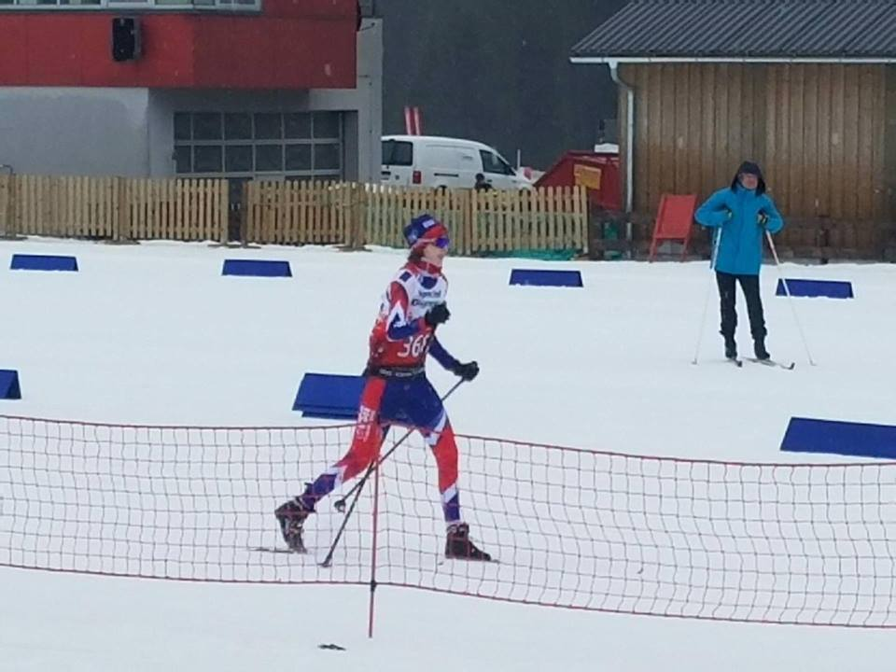
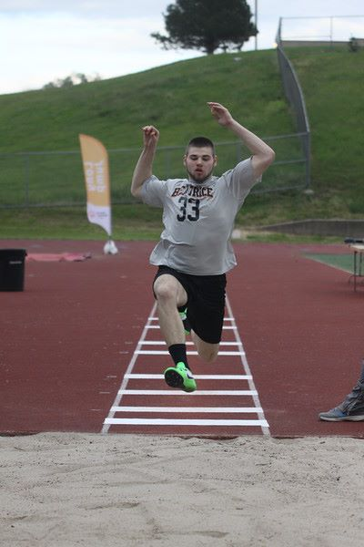
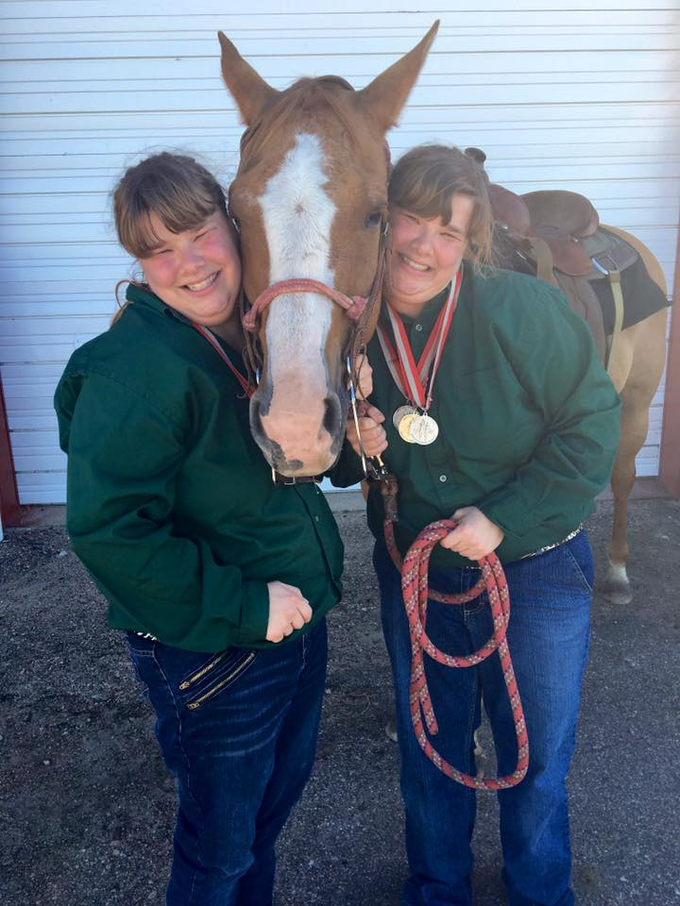
The Mission of Special Olympics
Year-Round Sports Training

Slide 4
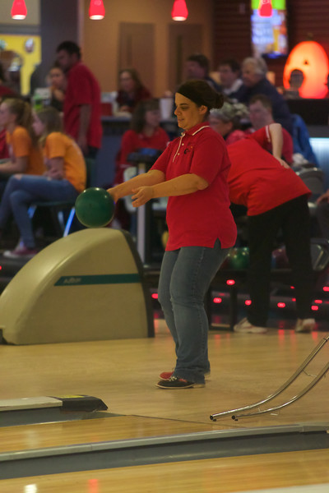
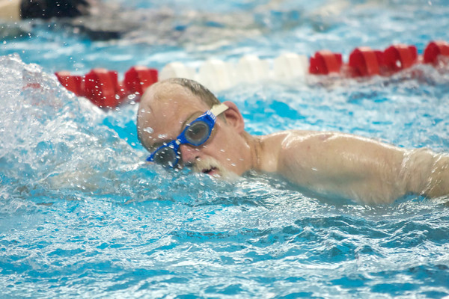
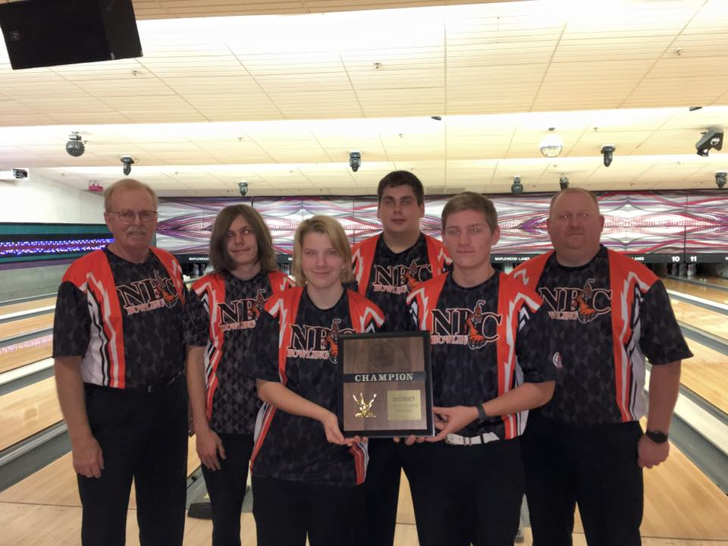
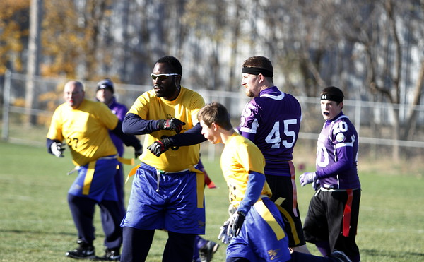
The Mission of Special Olympics
Athletic Competition

Slide 5
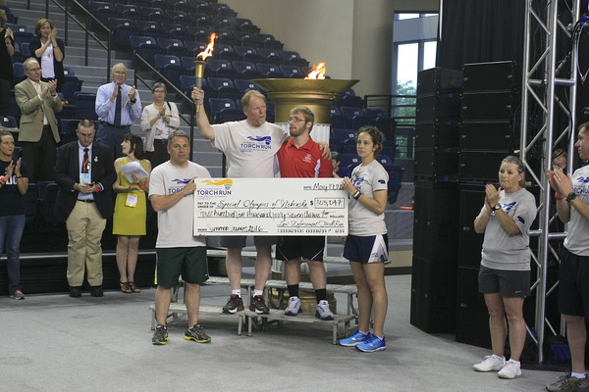
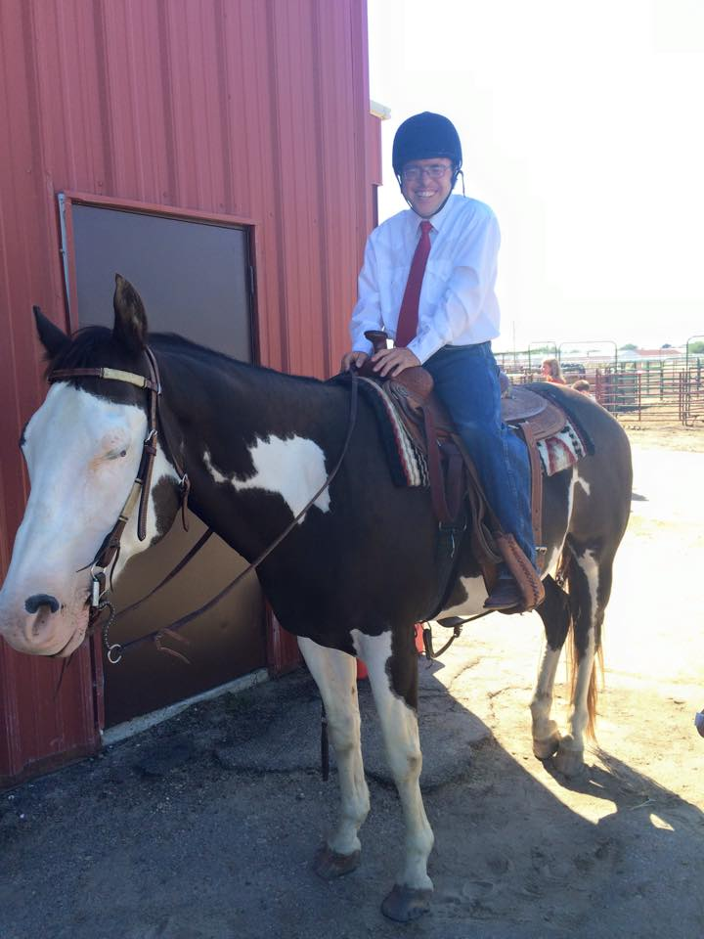
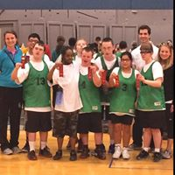
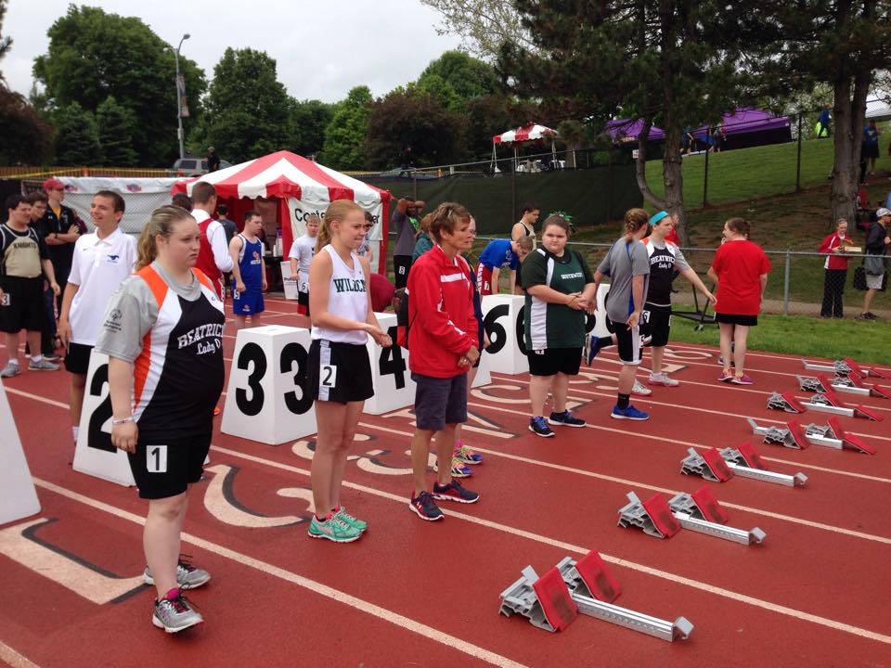
The Mission of Special Olympics
Olympic-Type Sports

Slide 6
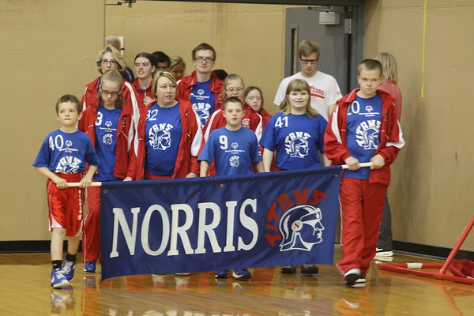
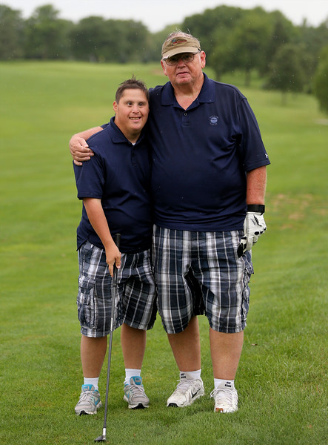
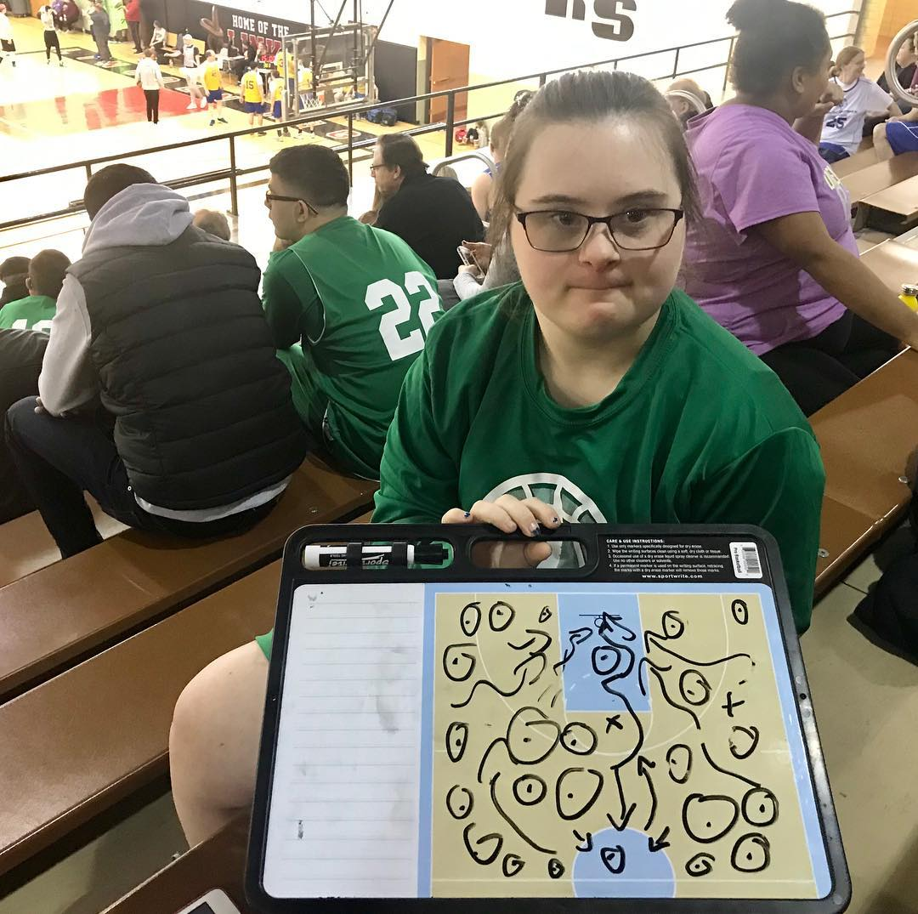
The Mission of Special Olympics
Children and adults (eight years old or older) with intellectual disabilities

Slide 7

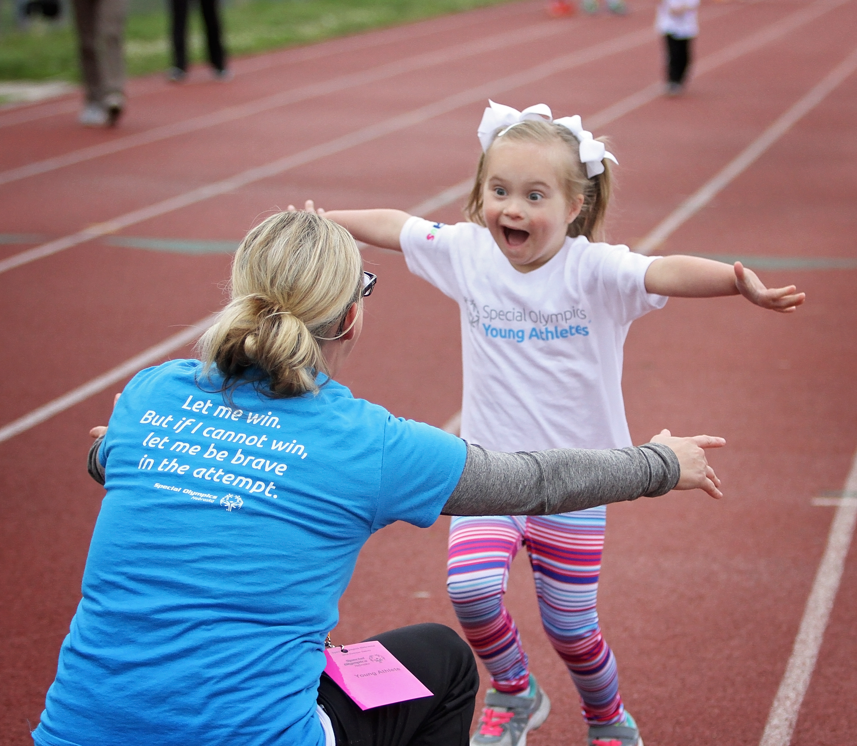
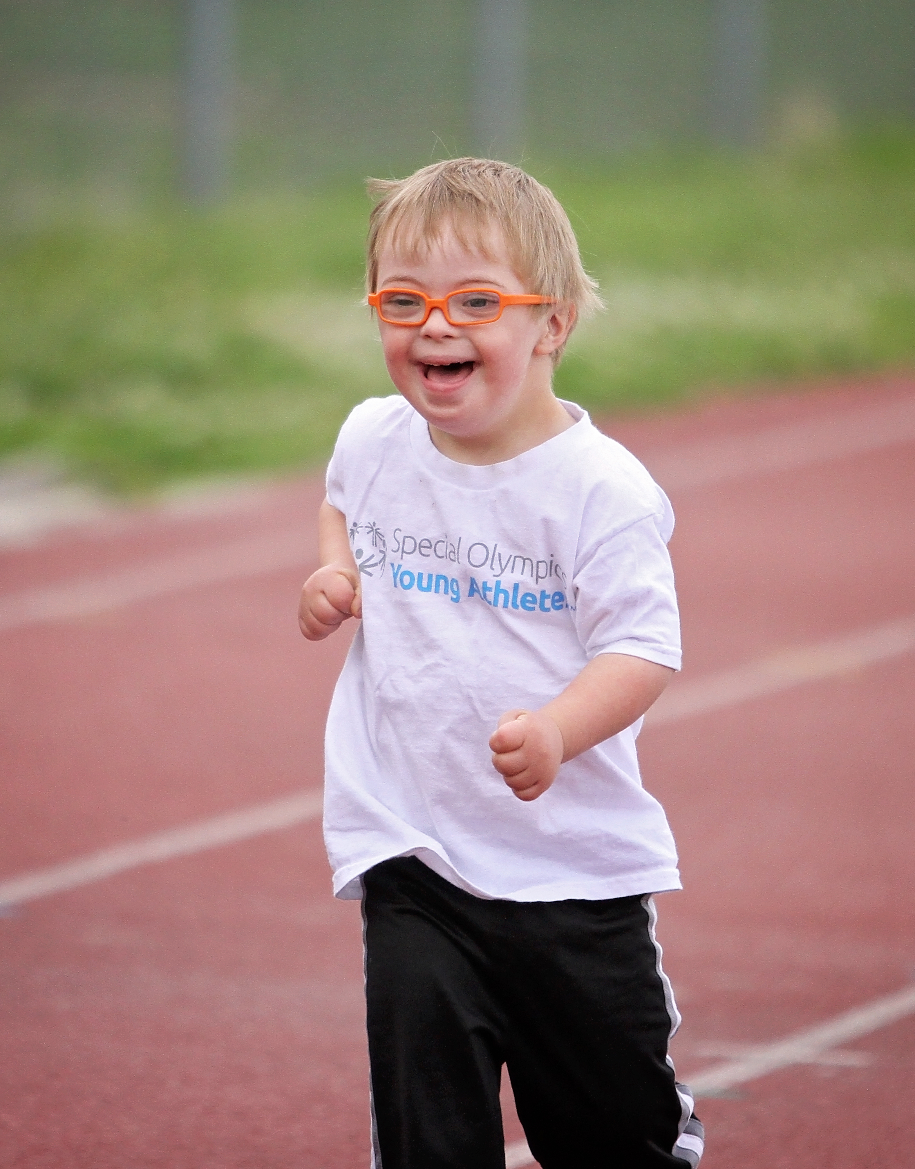
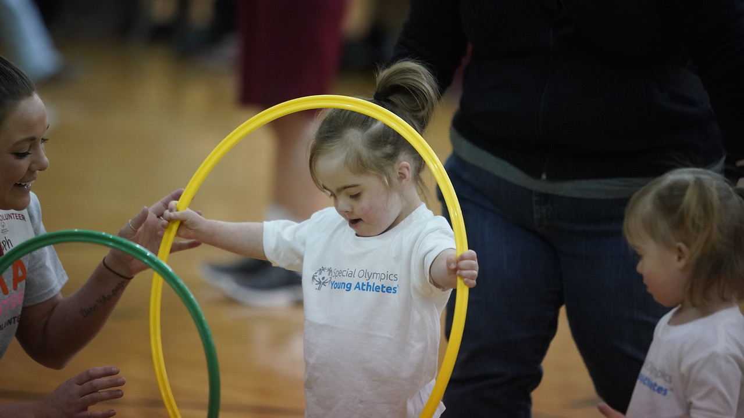
Open to participants 2-7 years old with and without disabilities

Slide 8
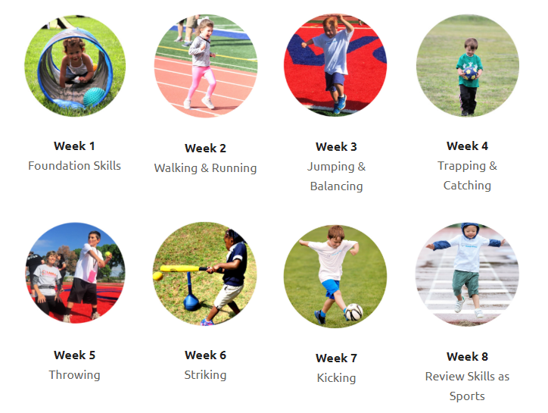
Young Athletes
Children of all abilities take part, and they all benefit.
“When my baby was born and I found out that he had an intellectual disability, my world fell apart. At Young Athletes, I see him move about, smiling, mixing freely with others and not holding on to the tail end of my skirt. It makes me cry tears of happiness and restores my hope that he can be independent one day. Now I dare to dream and plan to play baseball with my son when he grows up.” - Misae, Japan

Slide 9
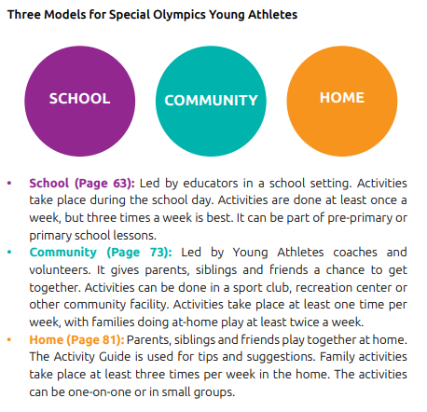


Slide 10
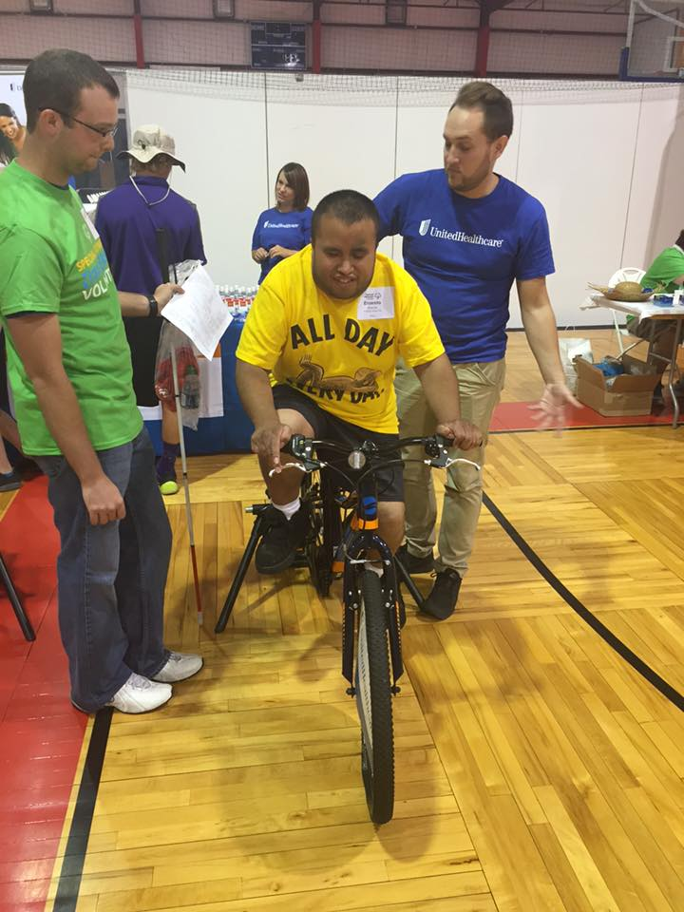
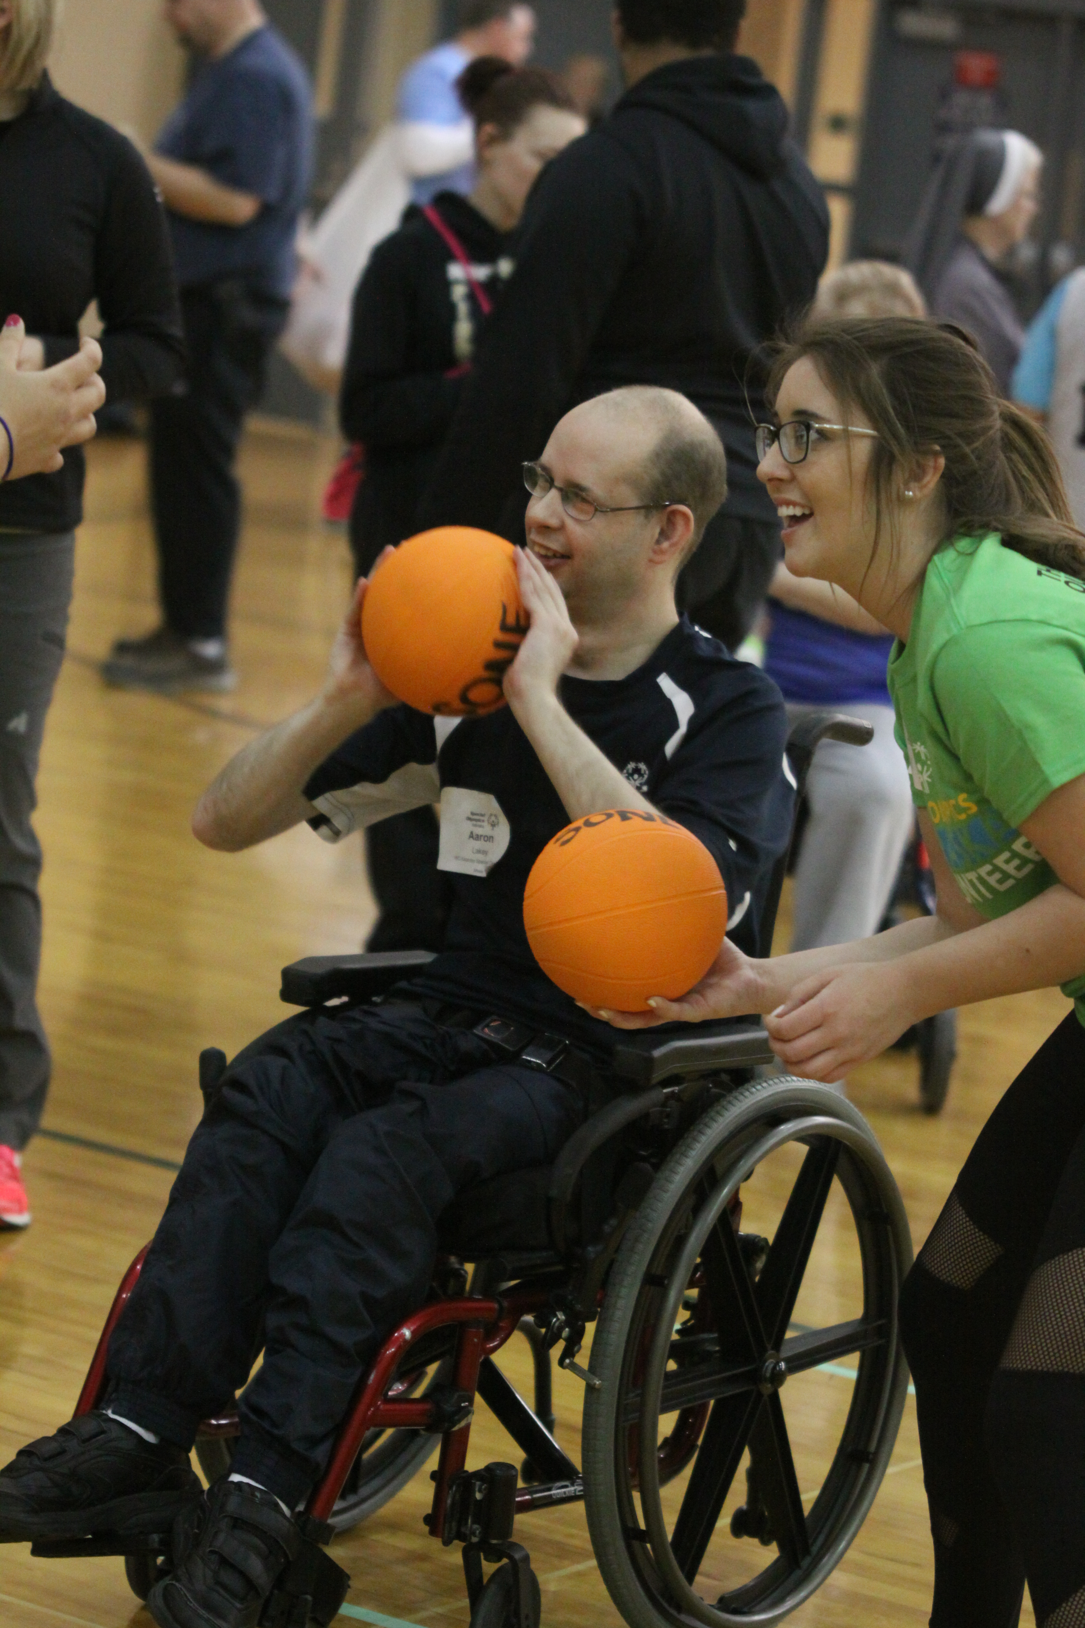
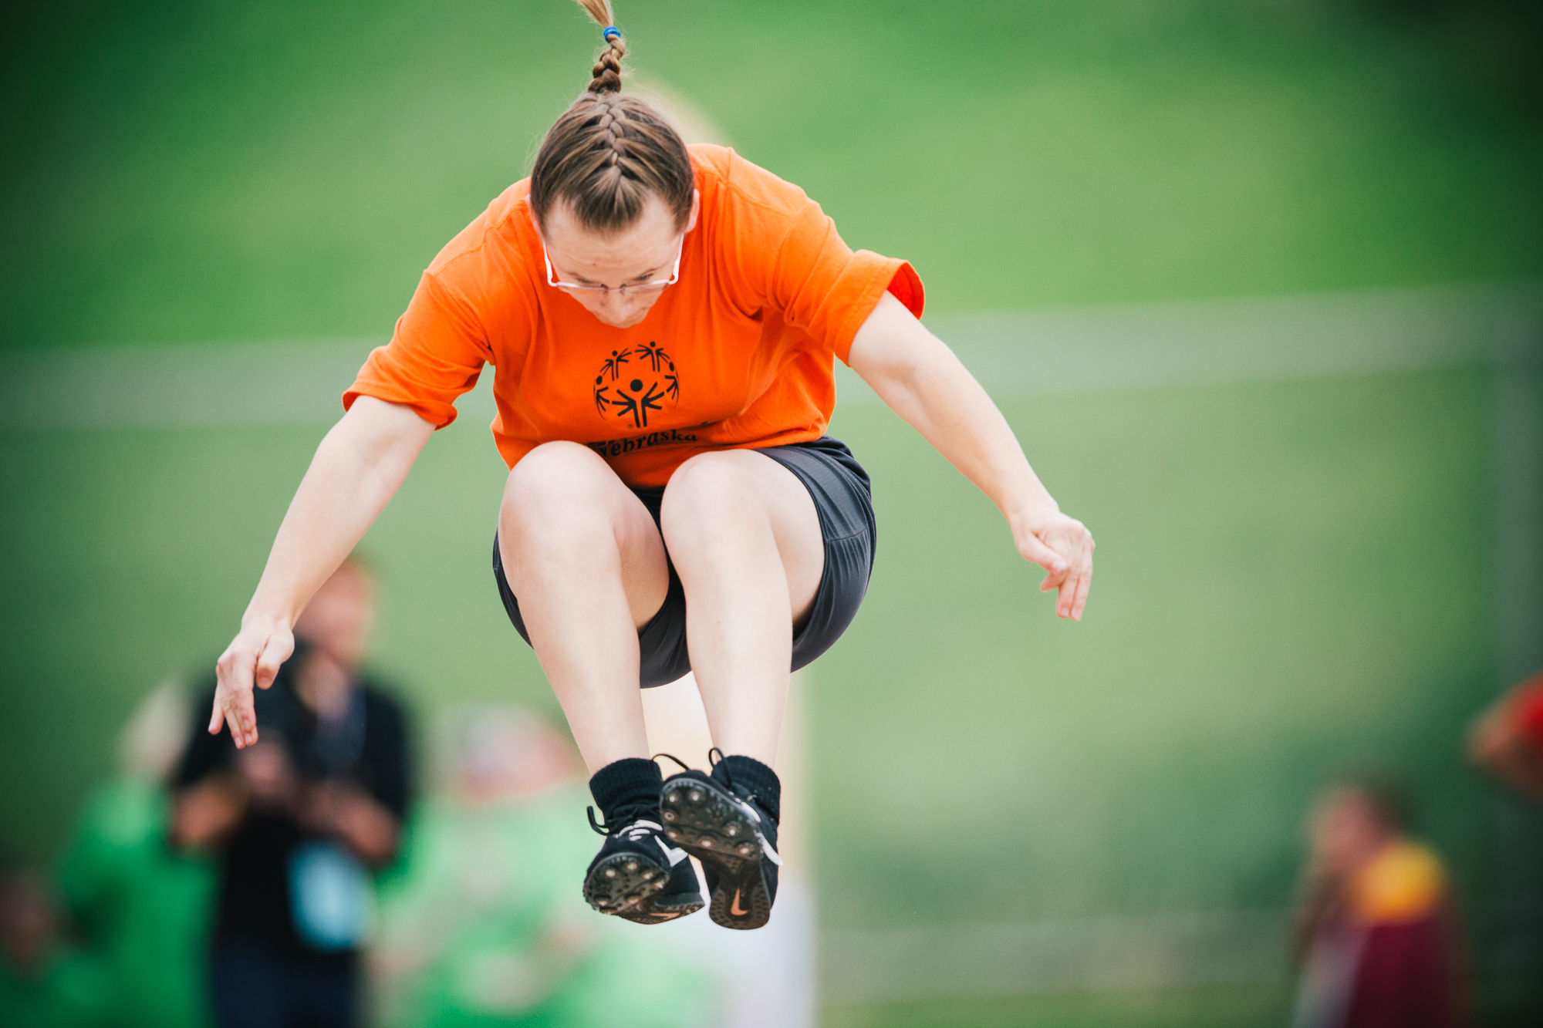
The Mission of Special Olympics
Develop Physical Fitness

Slide 11
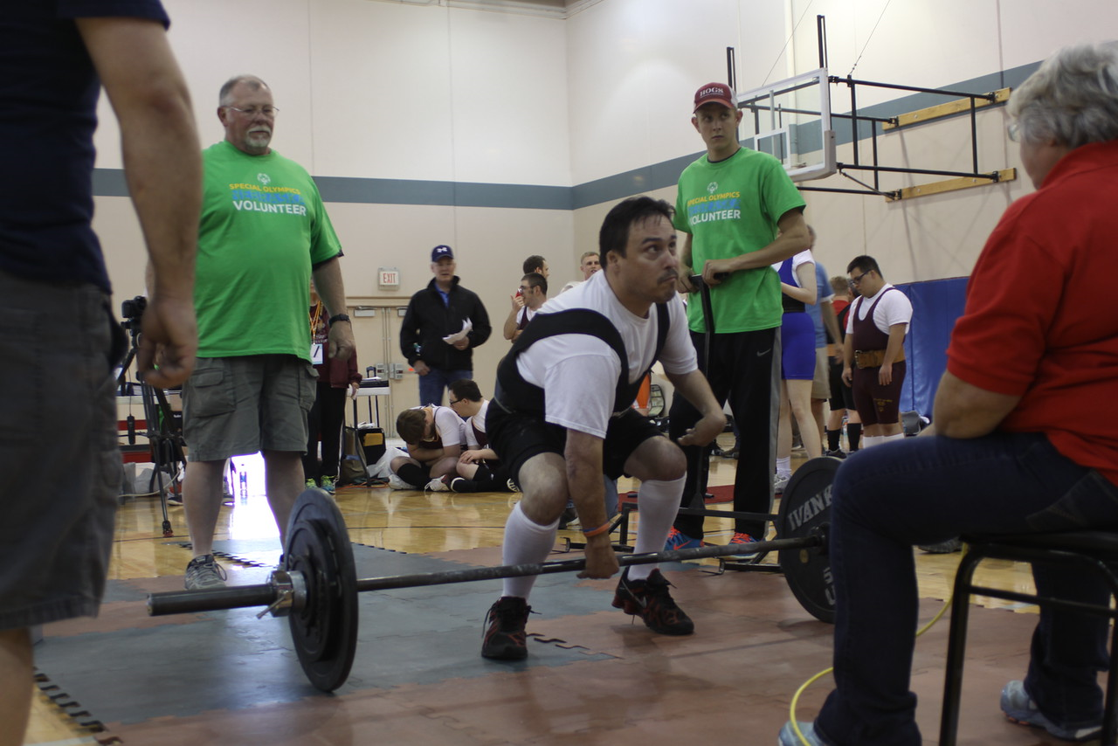
The Mission of Special Olympics
Demonstrate Courage

Slide 12
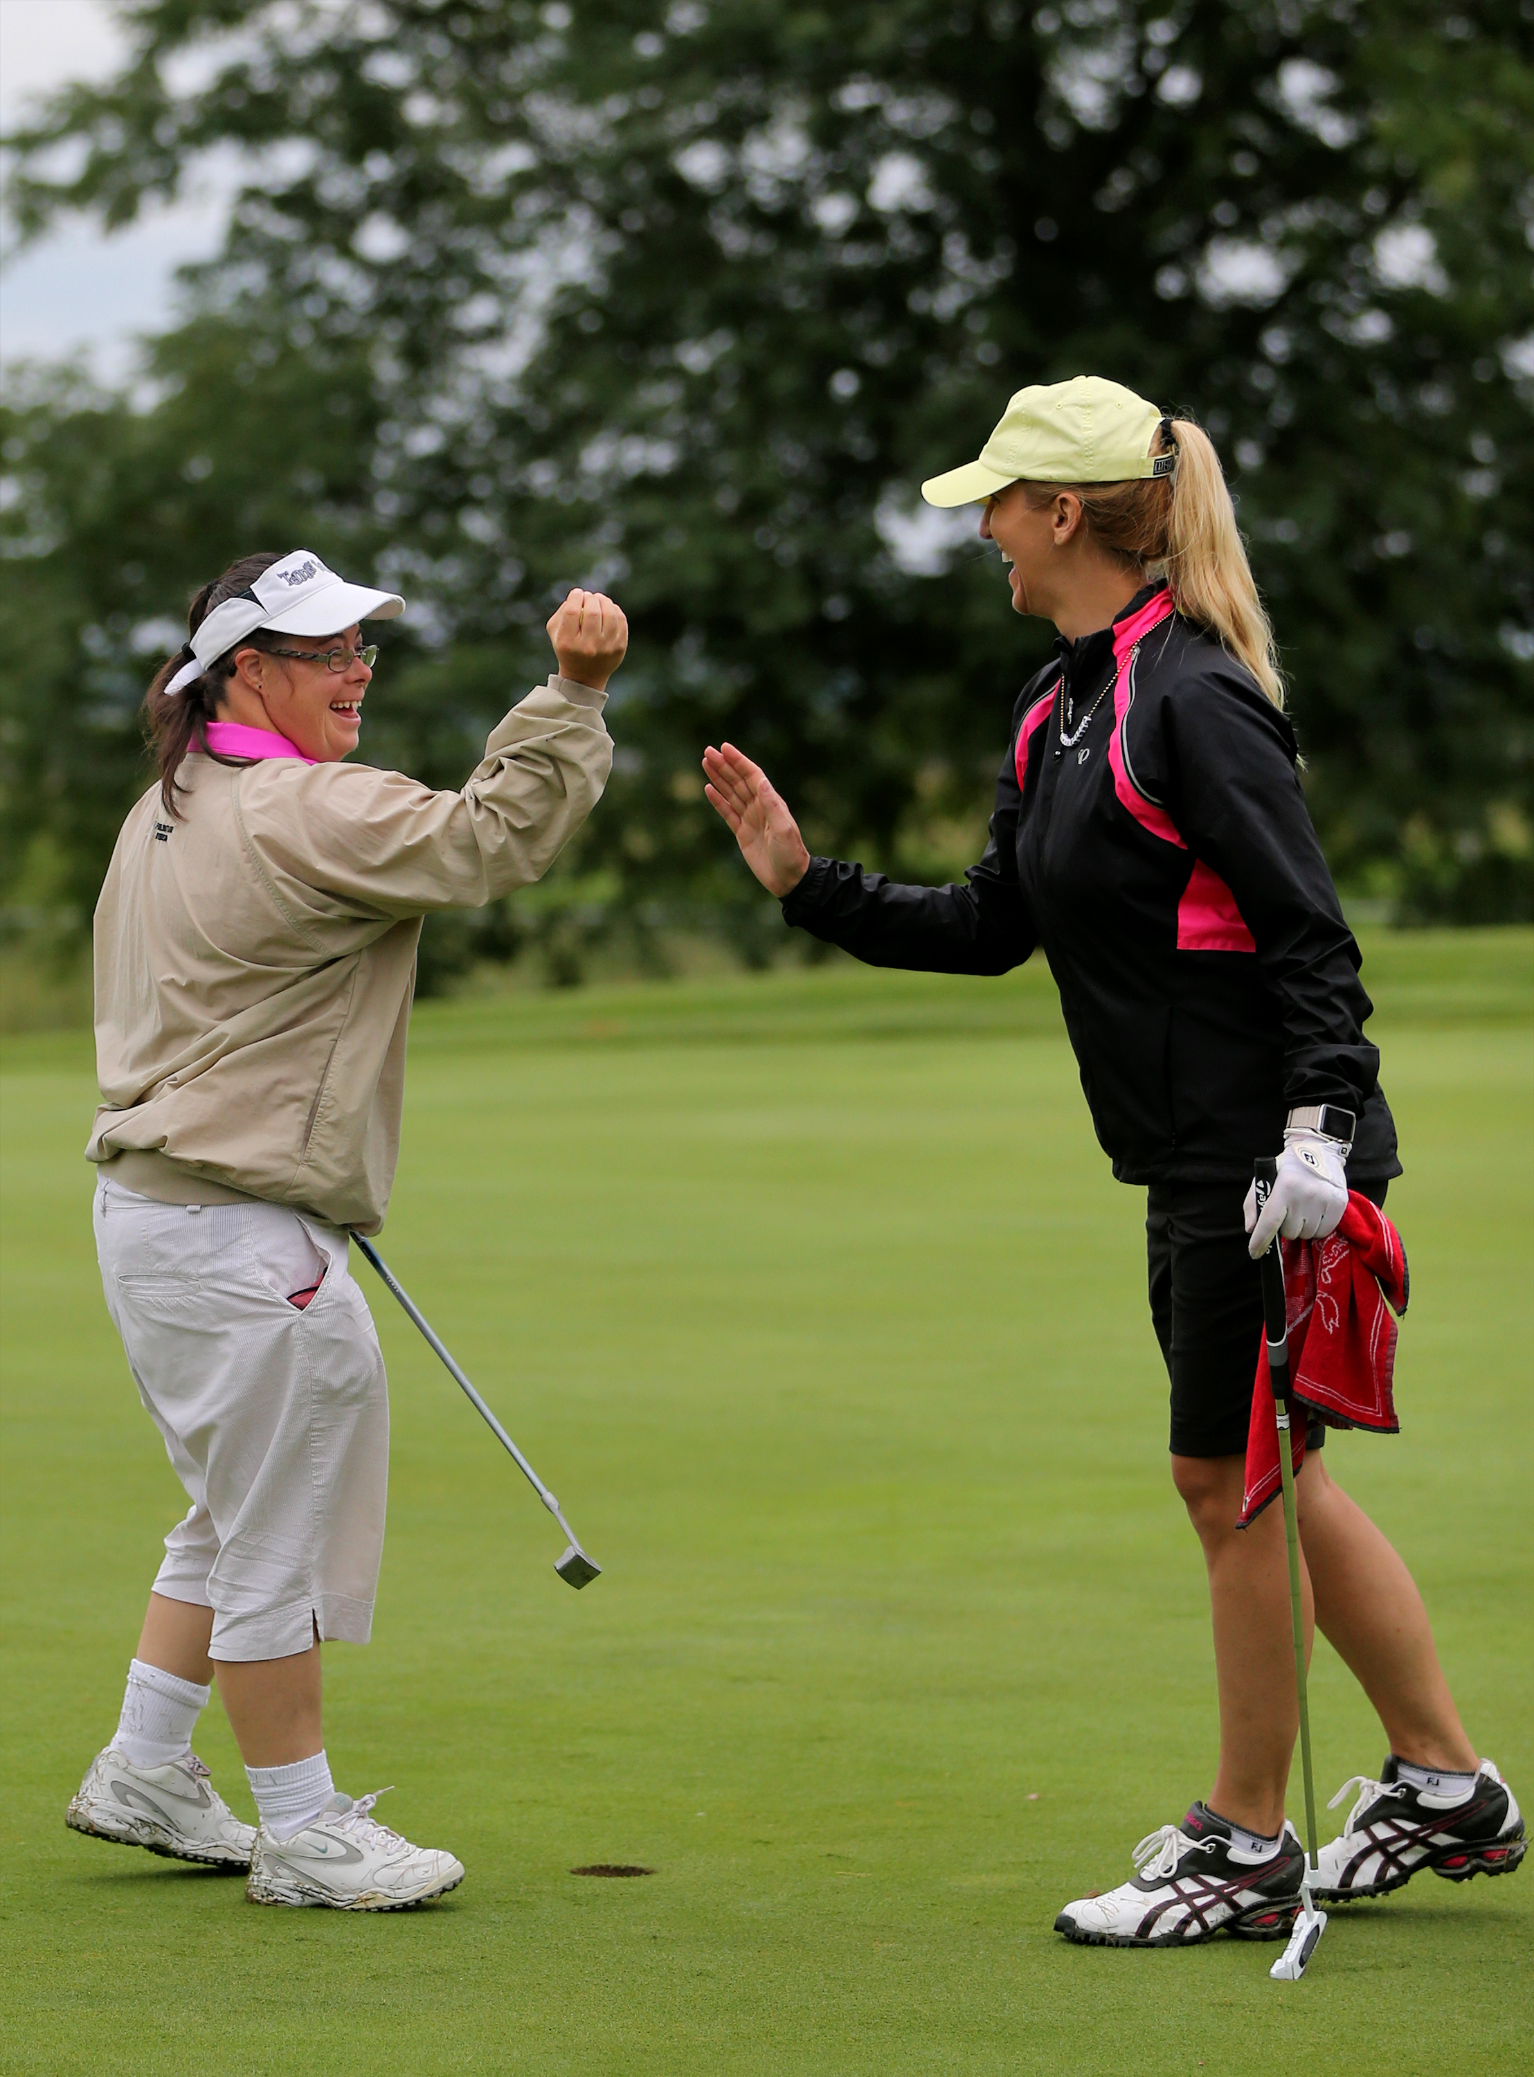
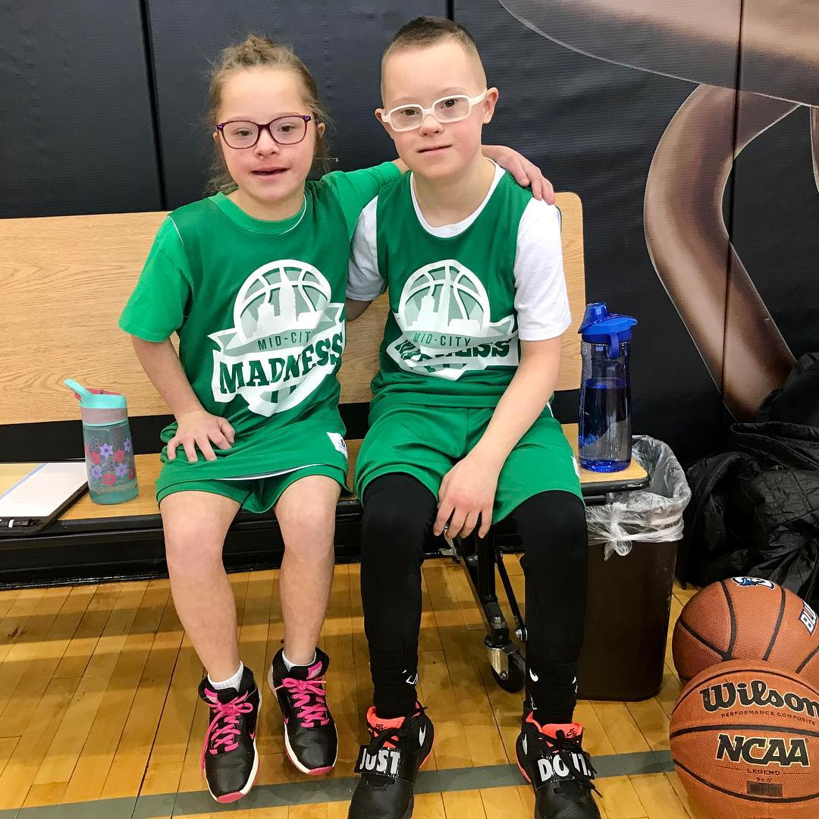
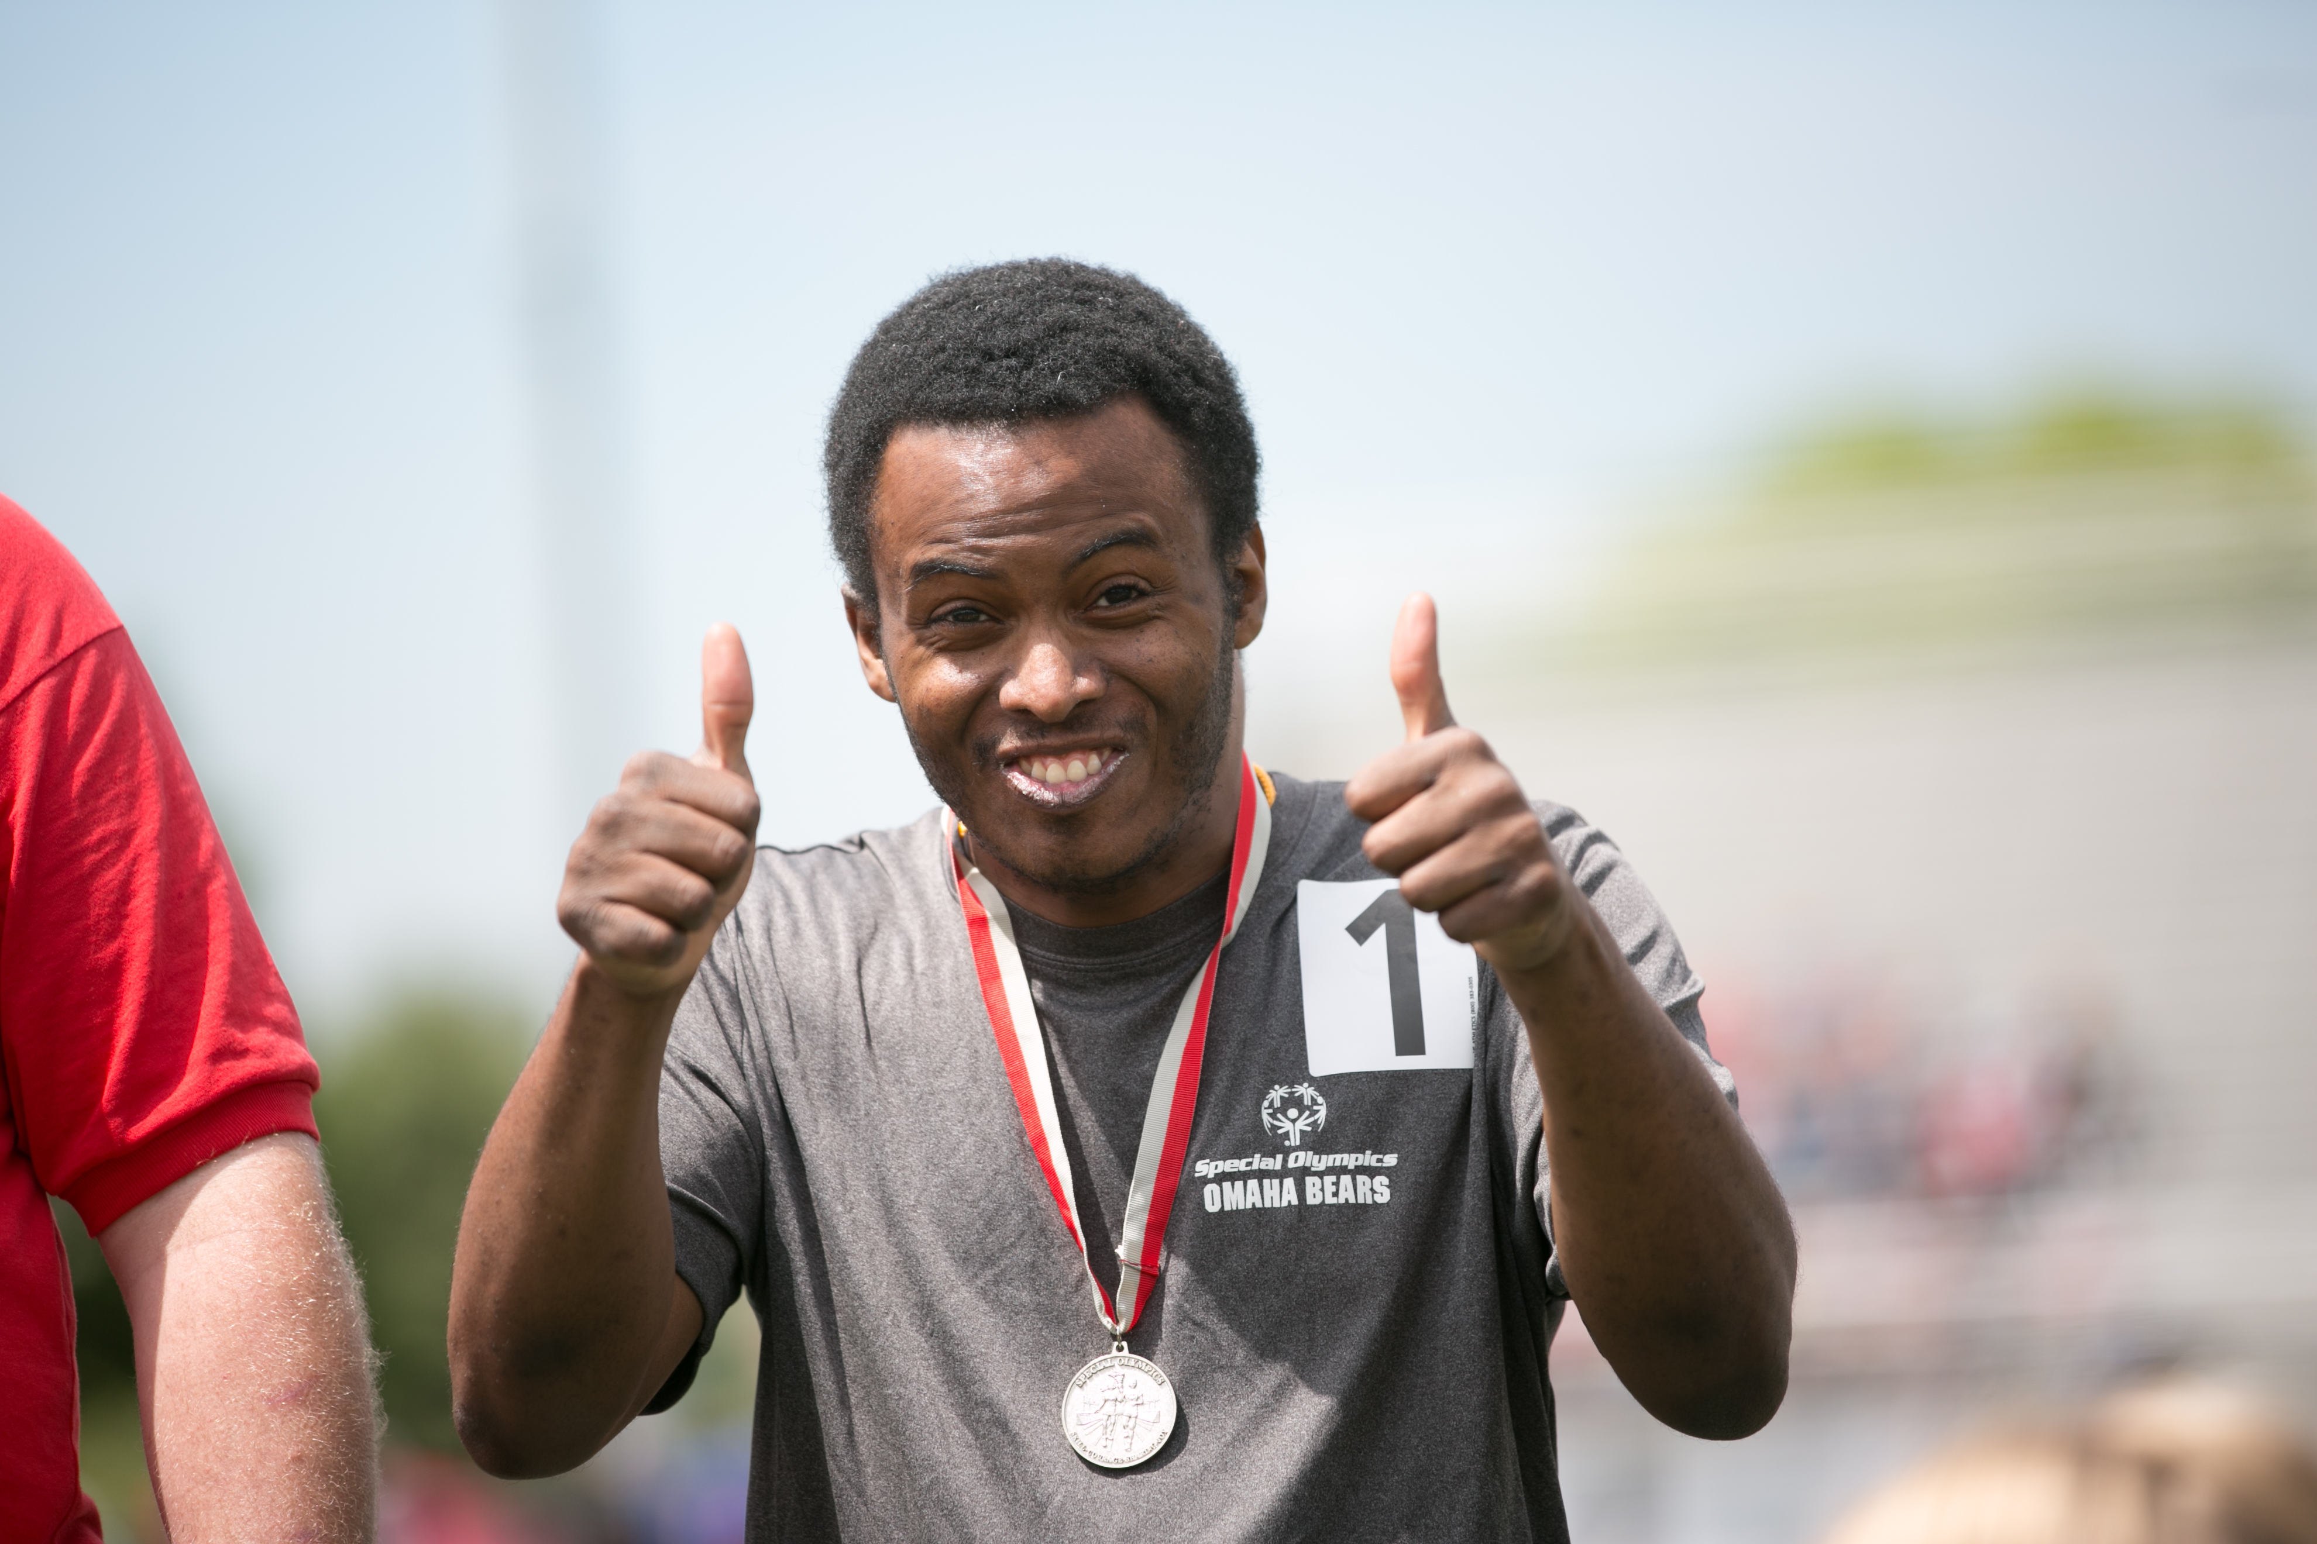
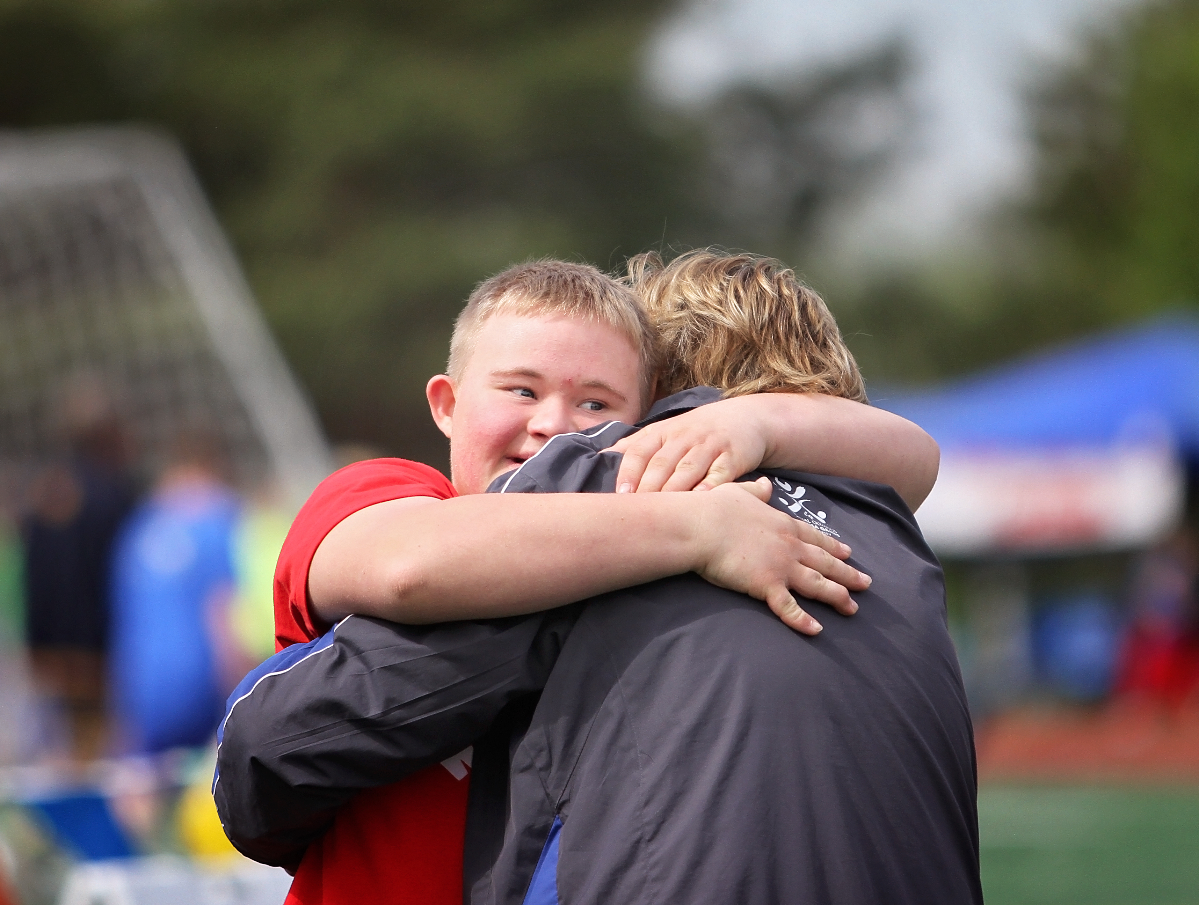
The Mission of Special Olympics
Experience Joy
Notes:
Tell me something about SO that is FUN!

Slide 13
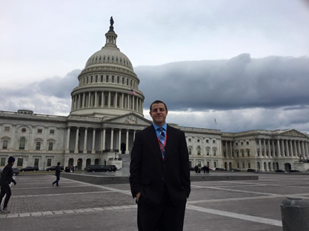
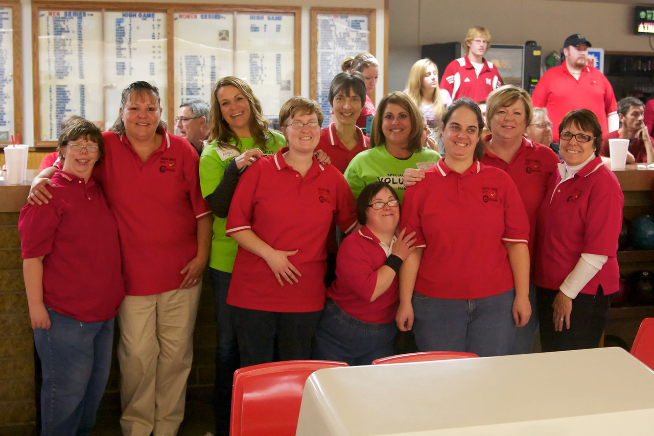
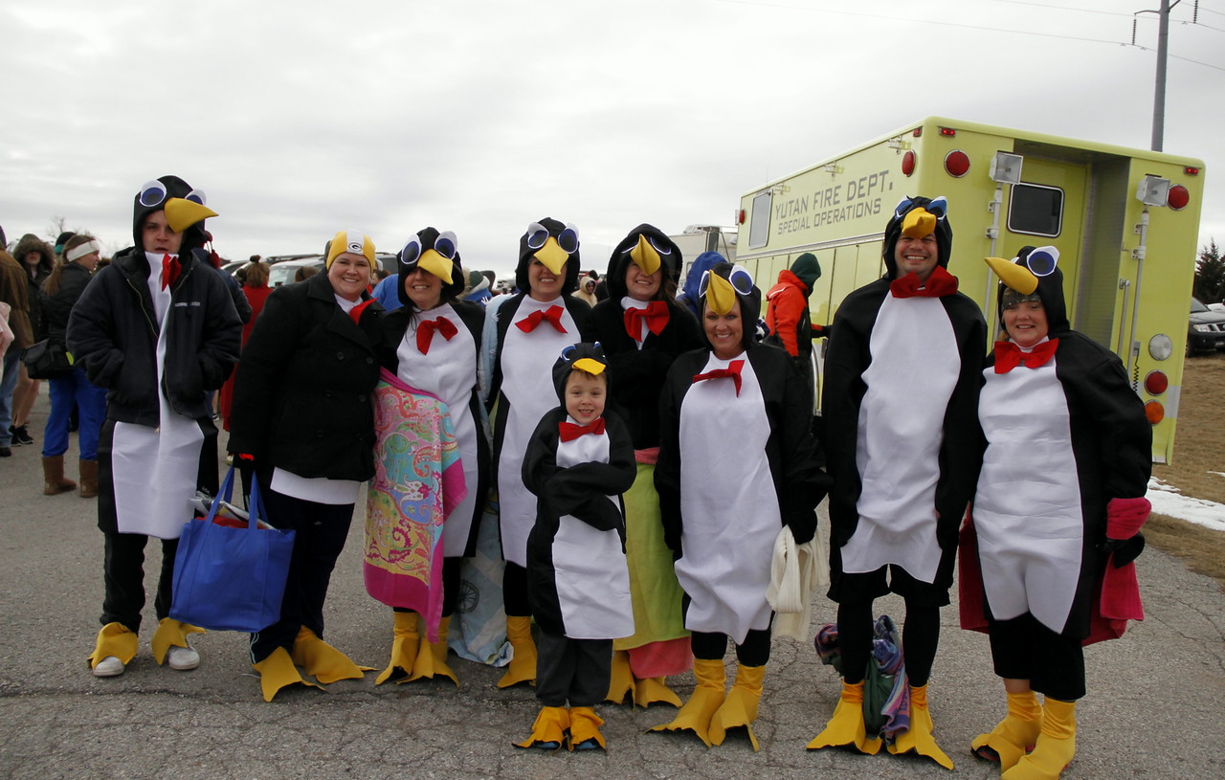
The Mission of Special Olympics
Share gifts, skills, and friendship with their families, other Special Olympics athletes, and the community.

Slide 14
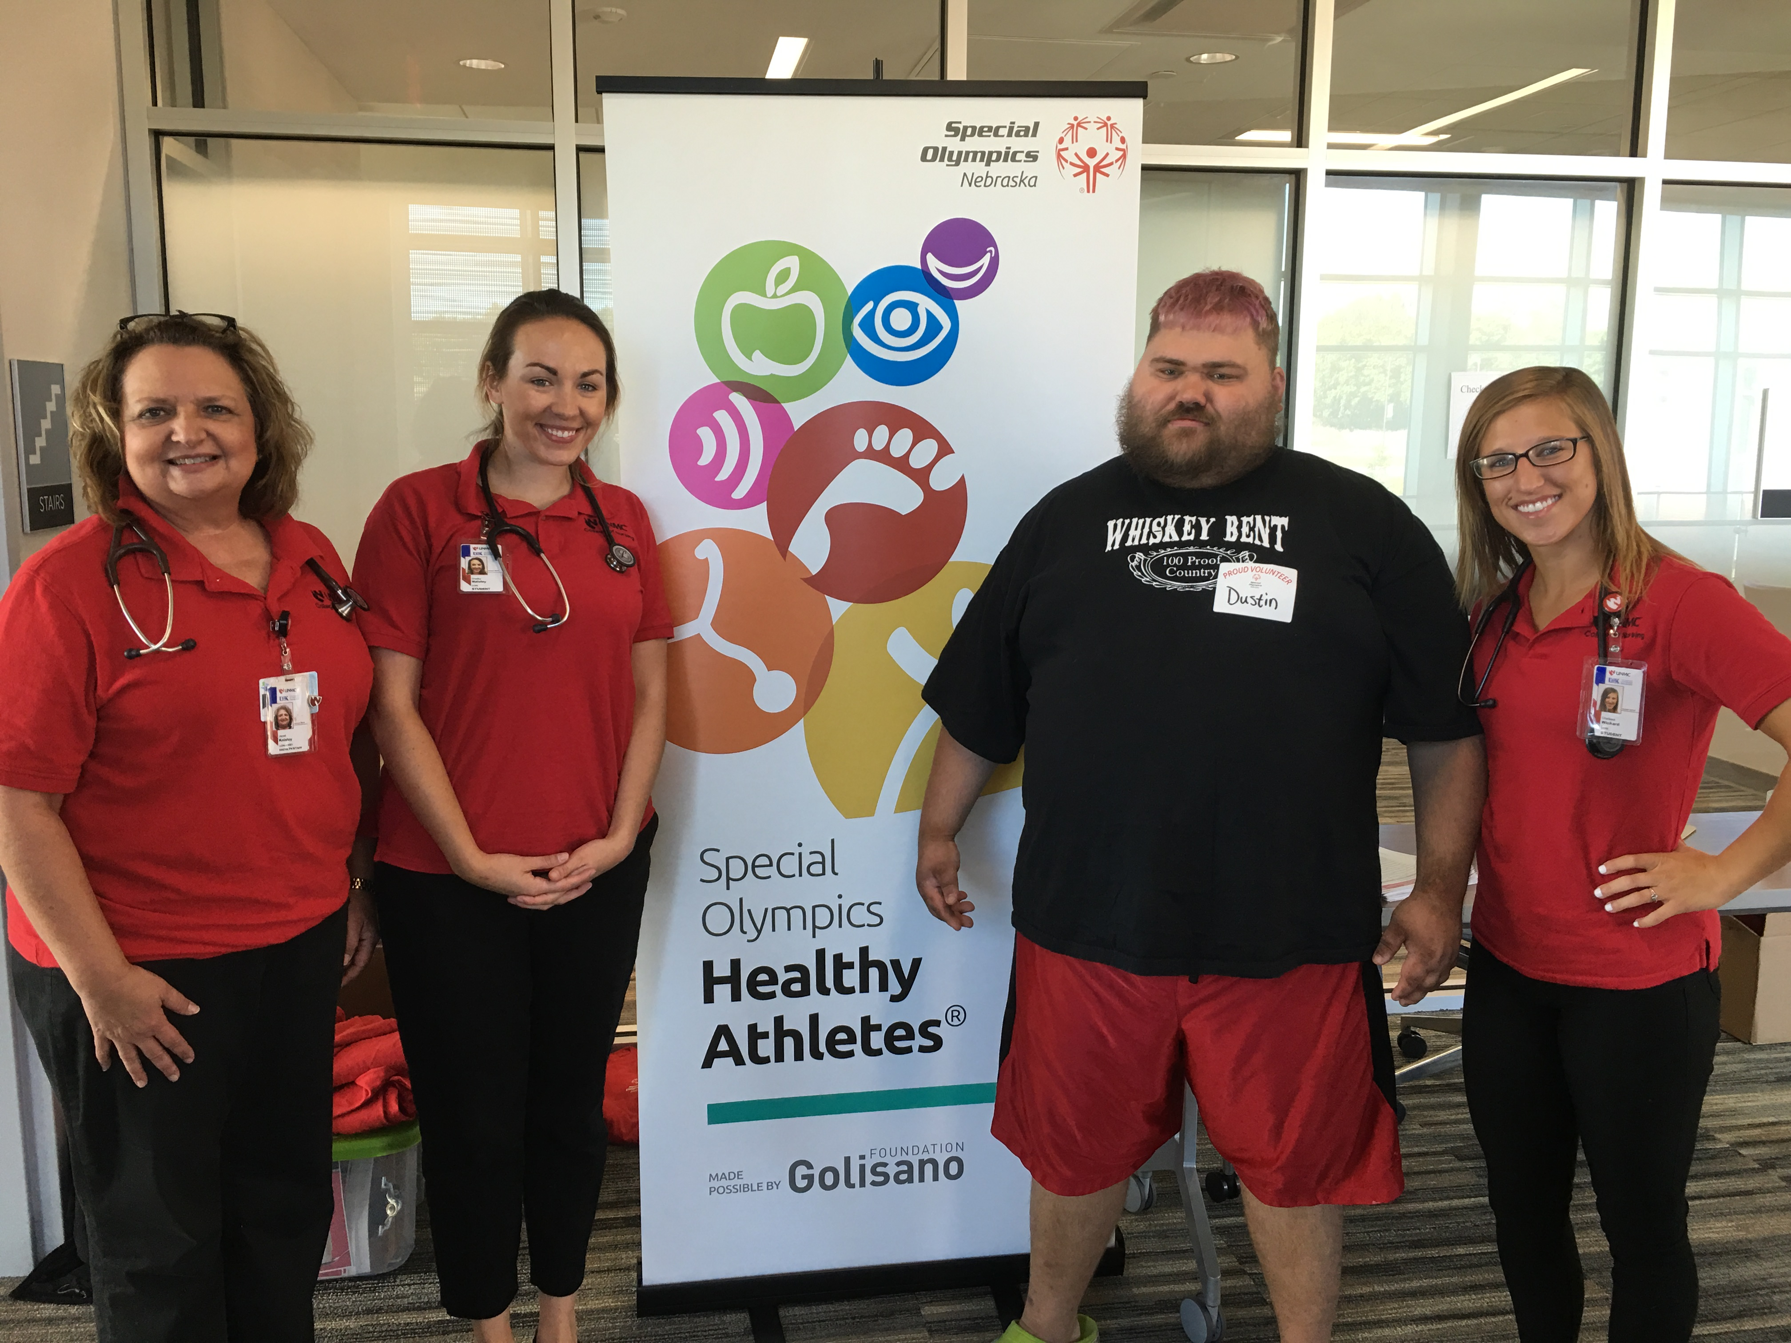
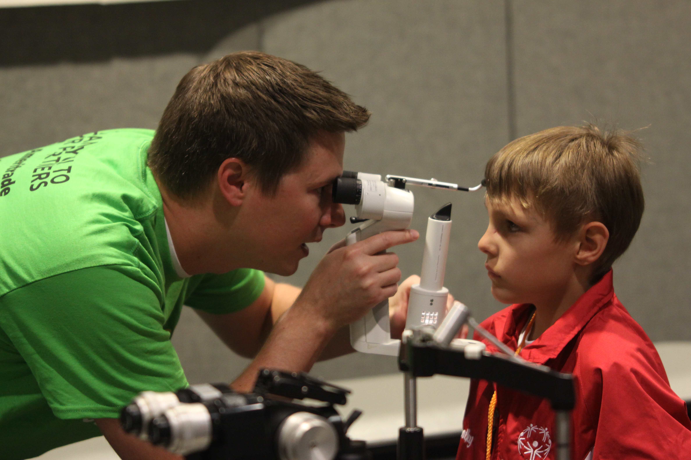
Health
Promote Year Around Fitness
Provide Free Health Screenings in 8 disciplines

Slide 15
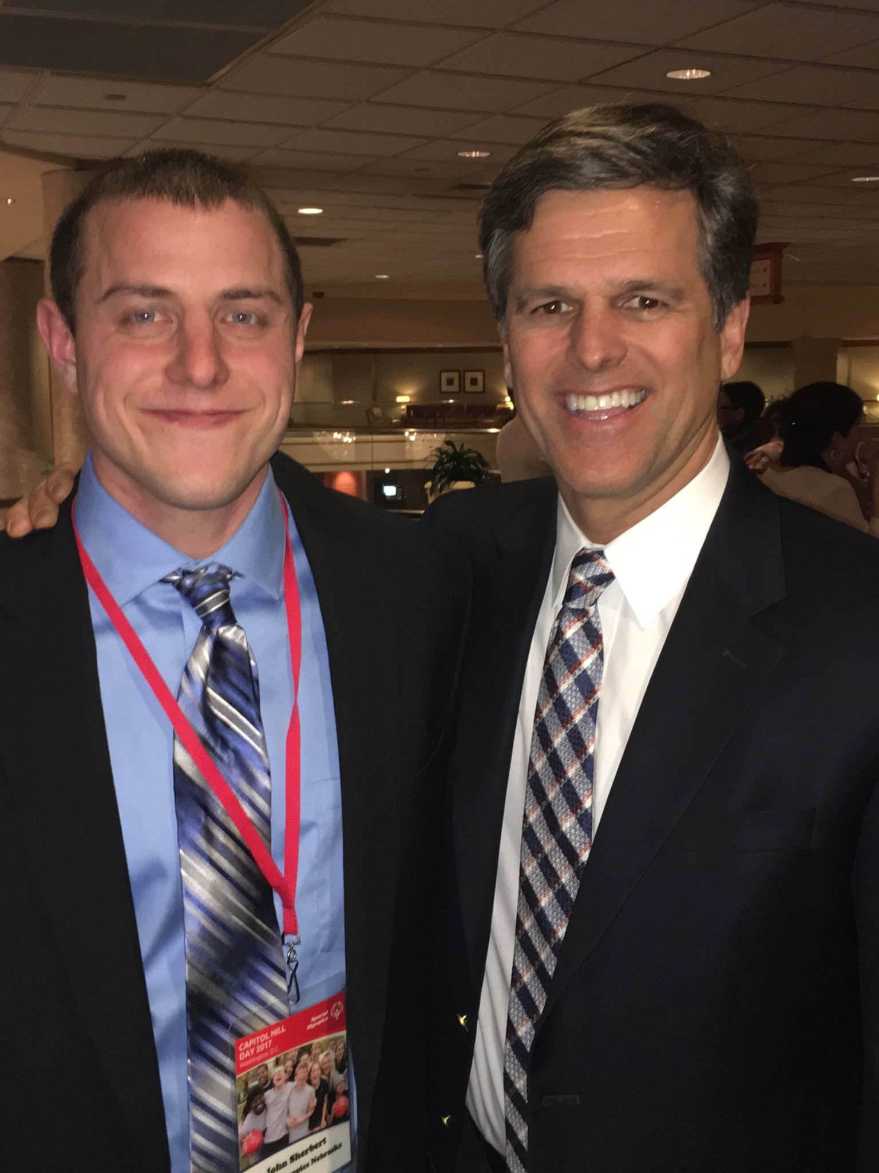
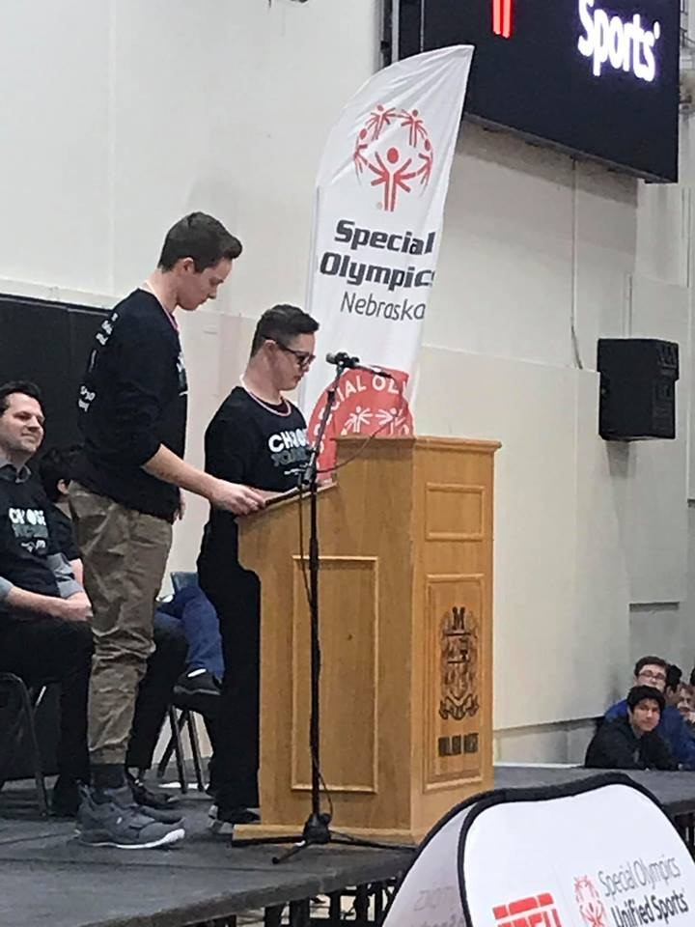
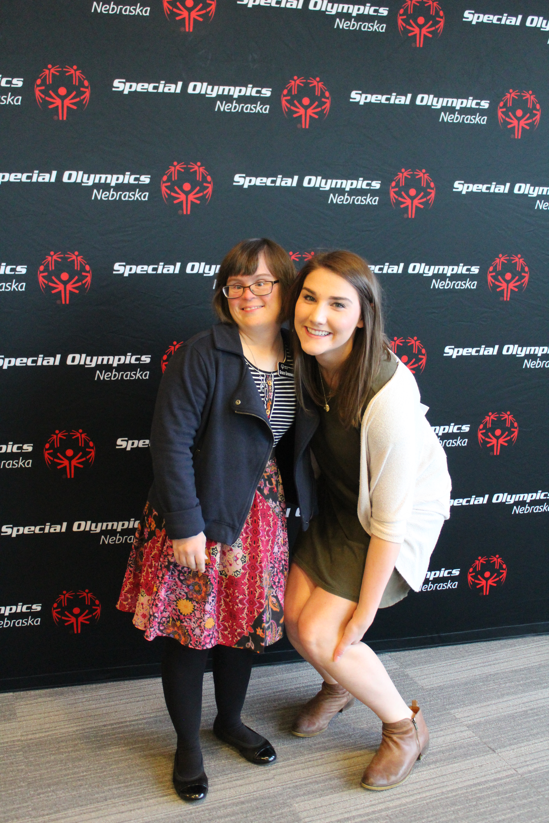
Athlete Leadership

Slide 16
What makes Special Olympics Unique?
No charge to athletes
Awards for all
Advancement to higher levels of competition
All ability levels
Divisioning
All abilities can participate in sports,
can achieve, & have value

Slide 17
Sports, Health & Education

Slide 18
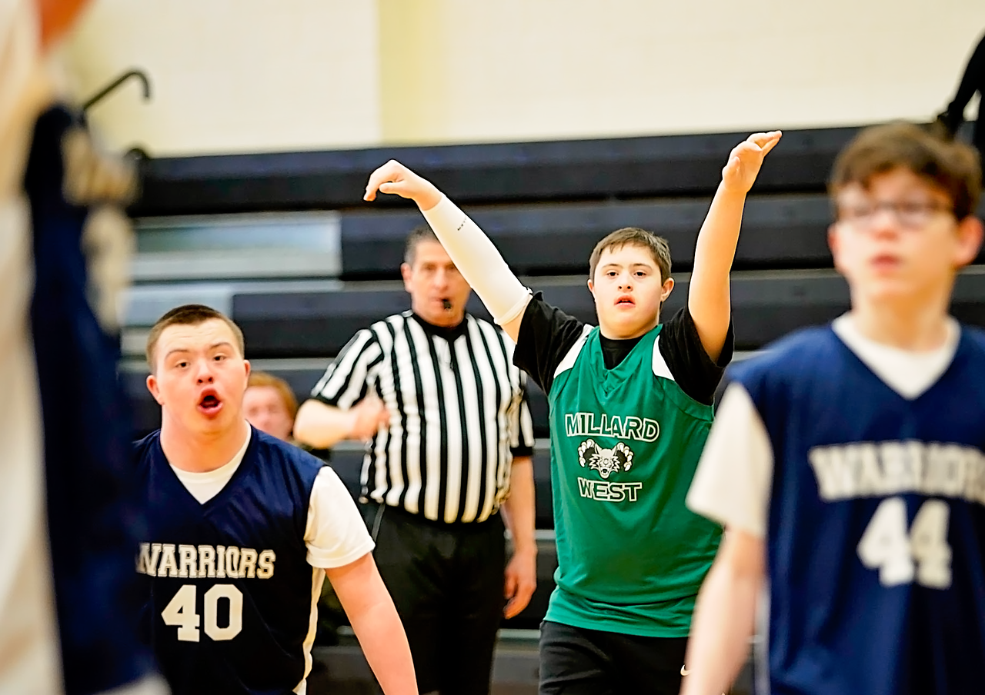
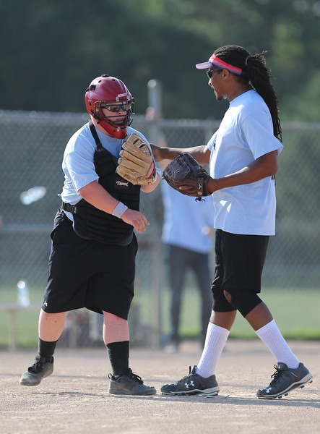
Sports
Traditional - Athlete compete against other Athletes
Unified- Athletes compete along with Unified Partners

Slide 19

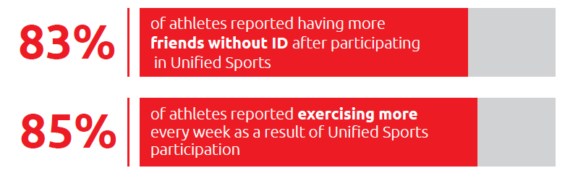
Inclusive Sports
Data
Notes:
Inclusive Sports
*Special Olympics Research Overview

Slide 20
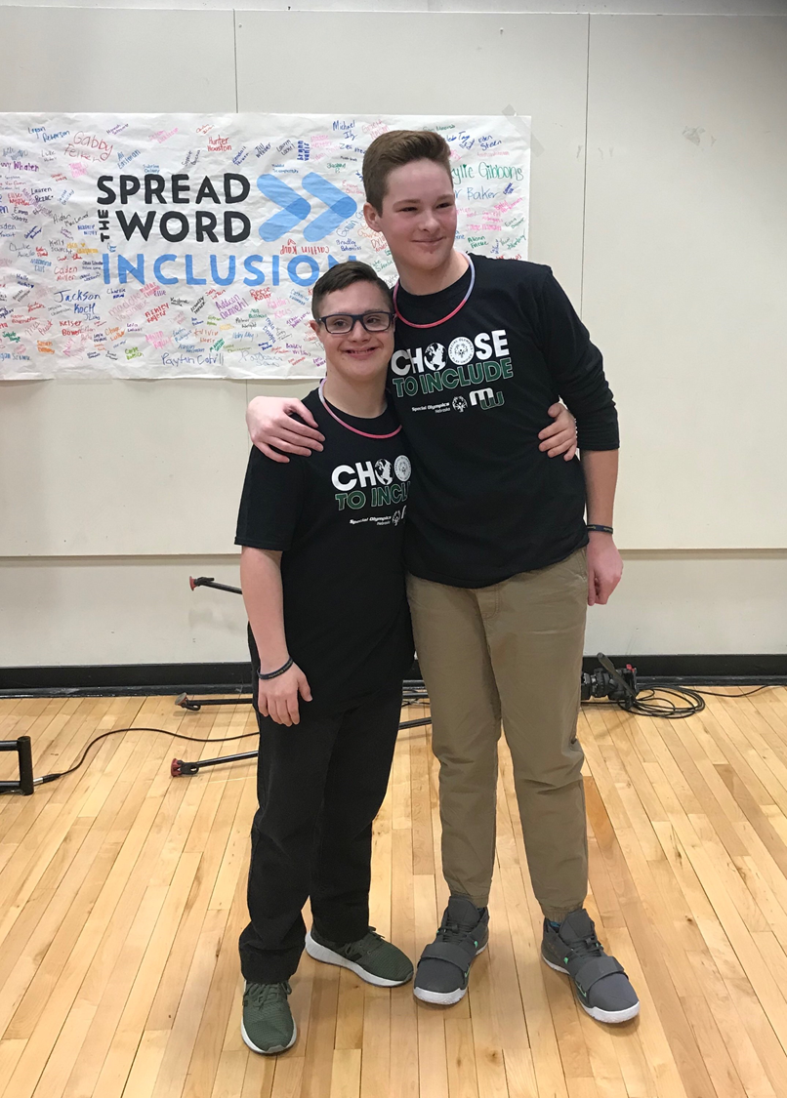
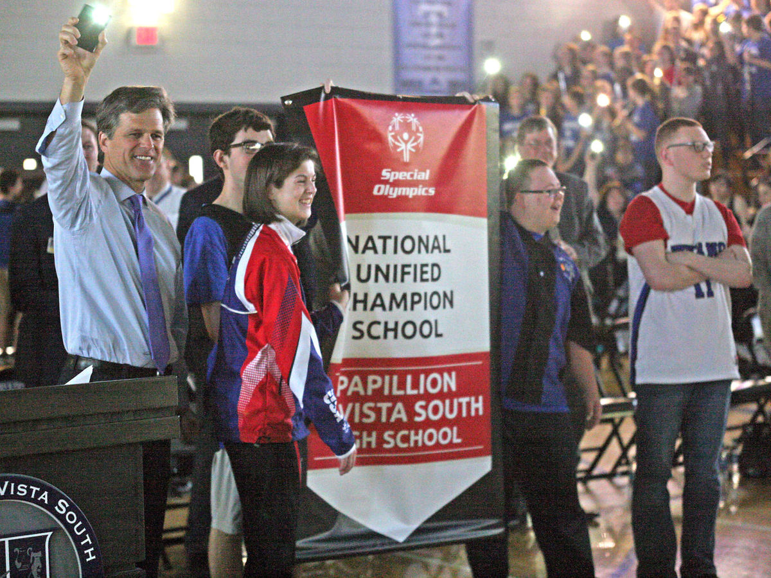
Education
Unified Schools in Nebraska
We are currently working with 221 schools across the state on bringing more Unified programming to their students
Notes:
Whole School Engagement
Awareness and education activities that promote inclusion and reach the majority of the school population, and all students in the school have opportunities to participate through sustained schoolwide activities.

Slide 21
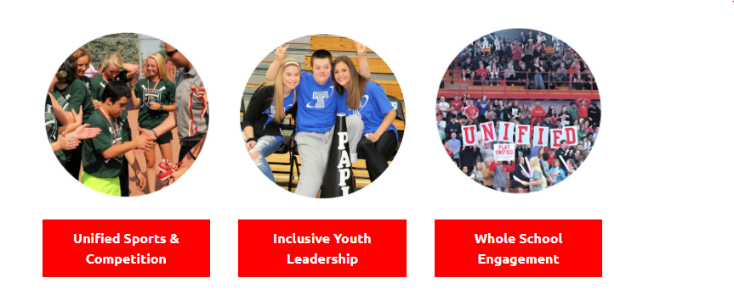

Slide 22
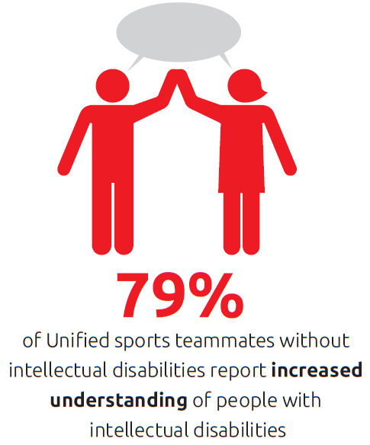
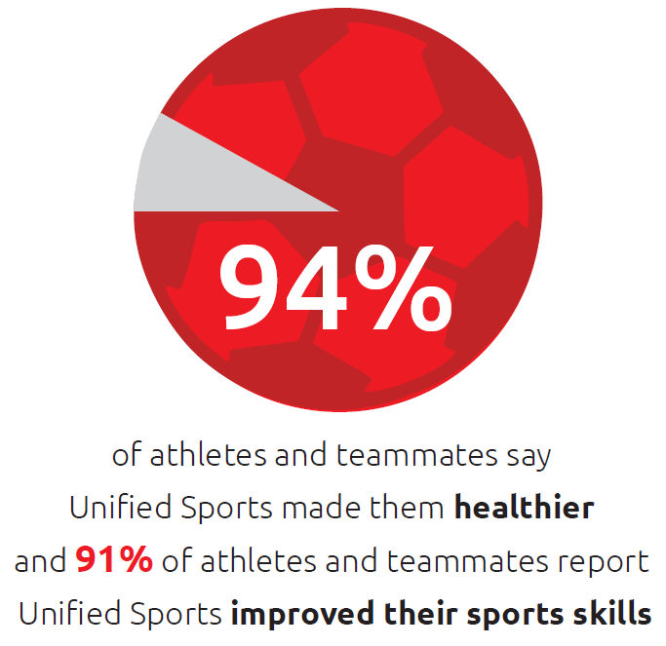
Inclusive Sports
Data
Notes:
Inclusive Sports
*Special Olympics Research Overview

Slide 23
At Home Resources for Covid 19

Slide 24
At Home Resources
Website:
https://www.sone.org/beyond-sports/at-home-resources.html
Facebook: https://www.facebook.com/sone.org/
Health & Wellness: https://www.facebook.com/SONEHealthWellness/
Contacts:
Alisa ahoffman@sone.org
Megan: mloberg-simmering@sone.org
www.sone.org

Slide 25
Questions

