Slide 1
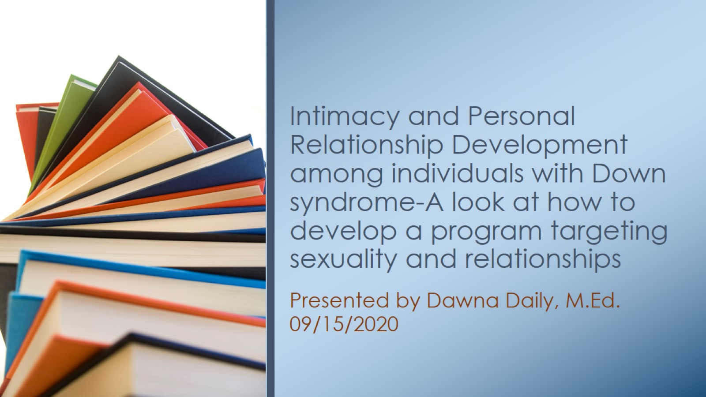
Intimacy and Personal Relationship Development among individuals with Down syndrome-A look at how to develop a program targeting sexuality and relationships

Slide 2
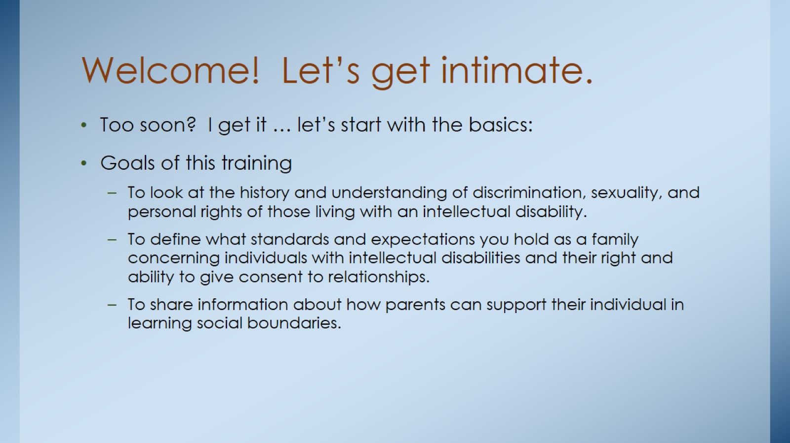
Welcome! Let’s get intimate.

Slide 3
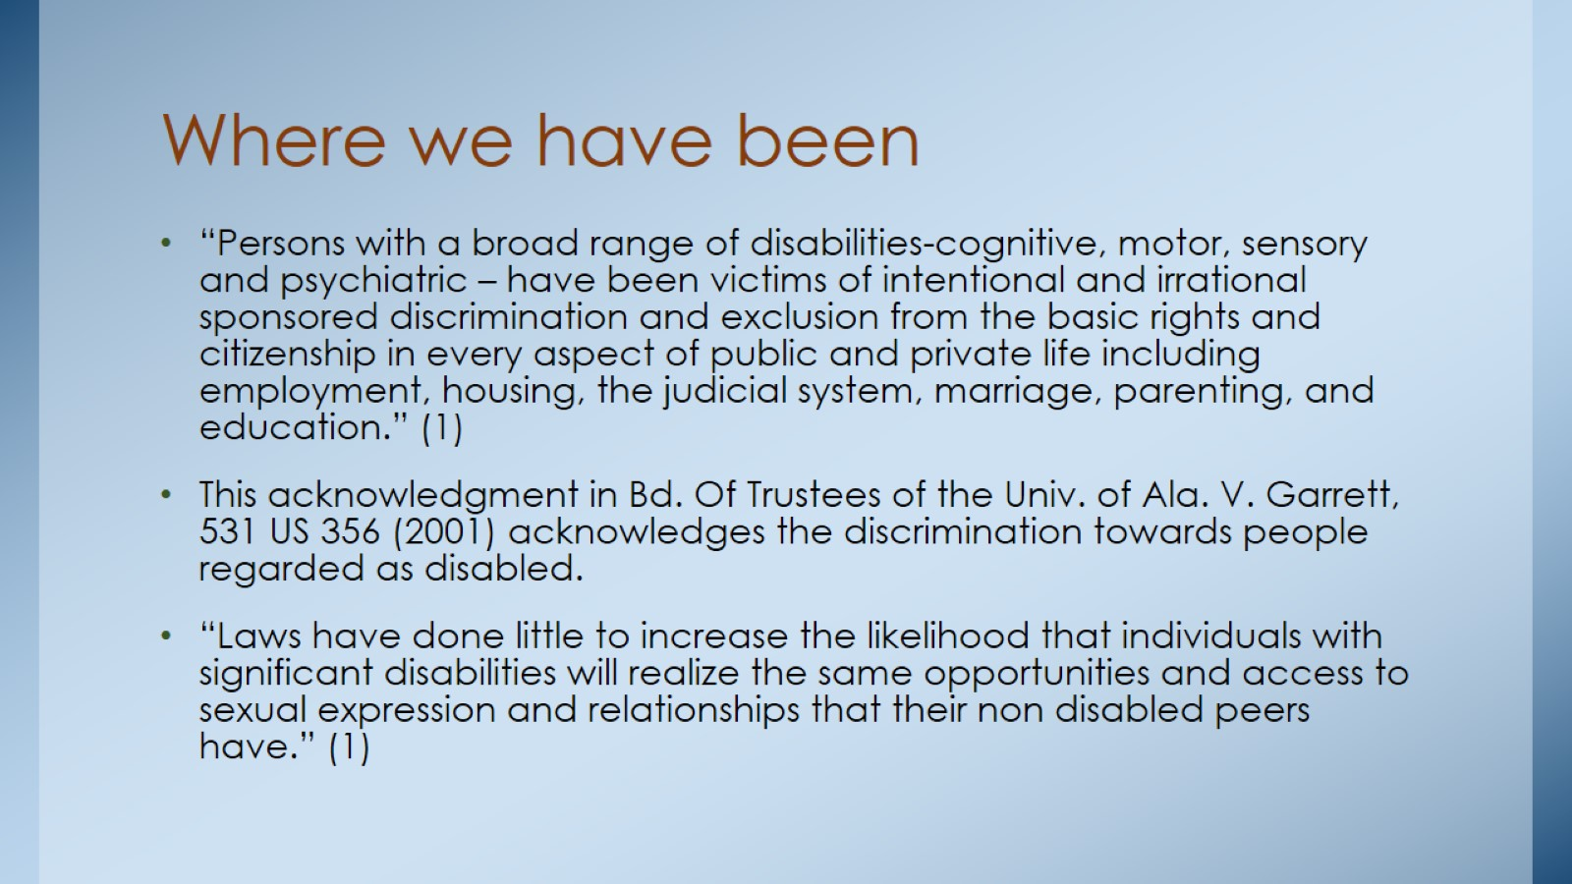
Where we have been

Slide 4
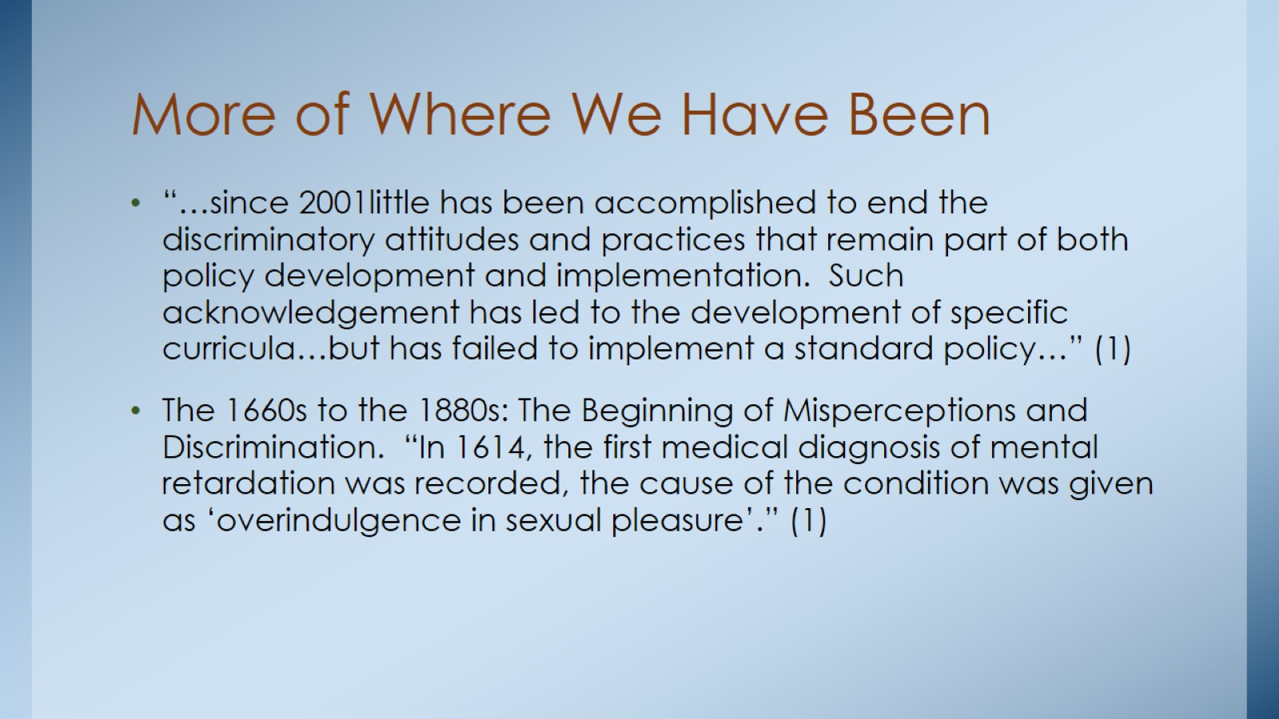
More of Where We Have Been

Slide 5
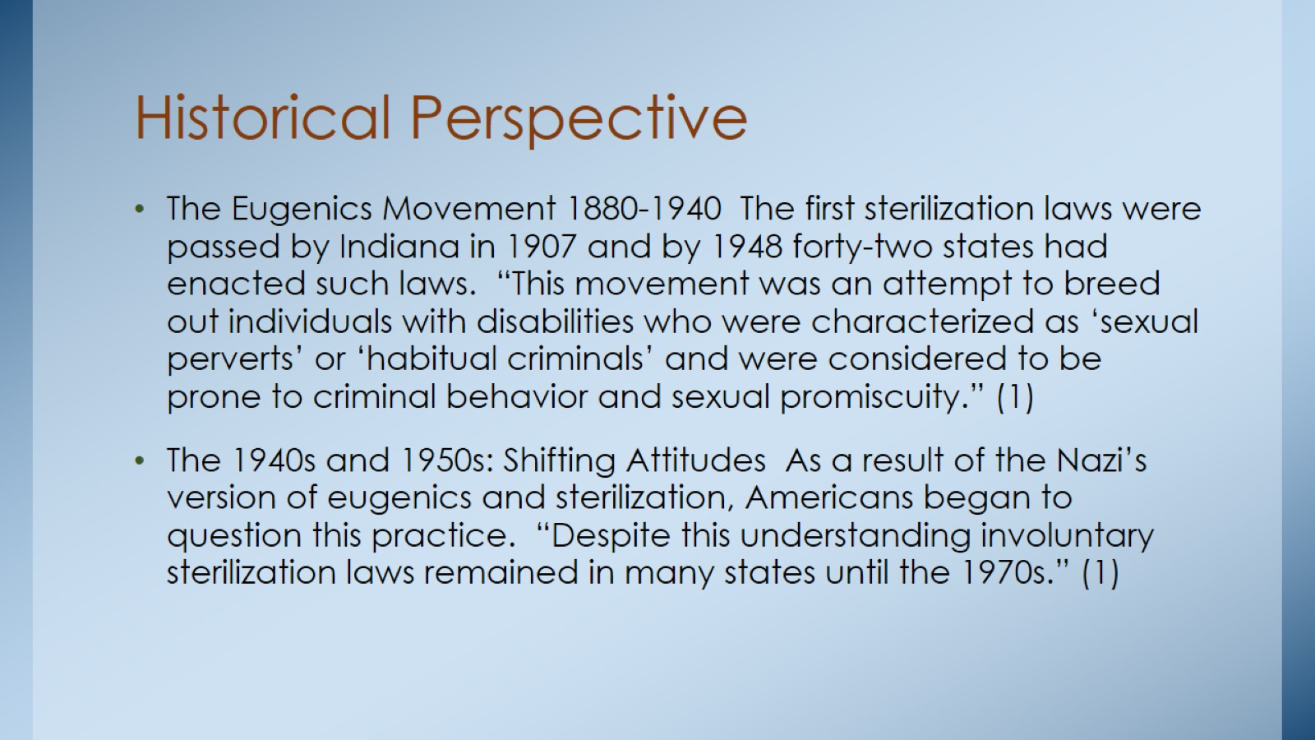
Historical Perspective

Slide 6
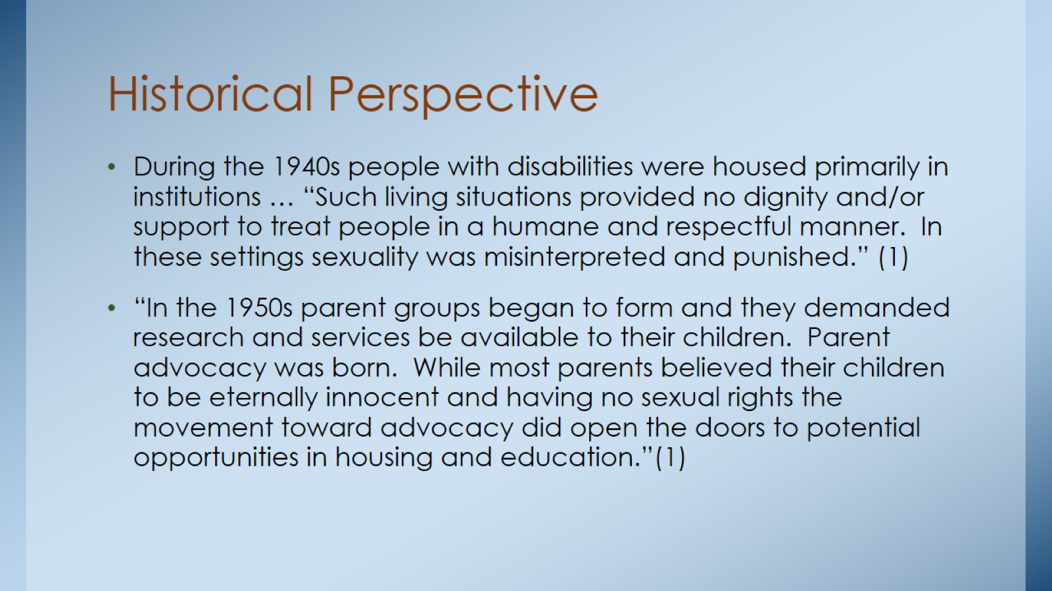
Historical Perspective

Slide 7
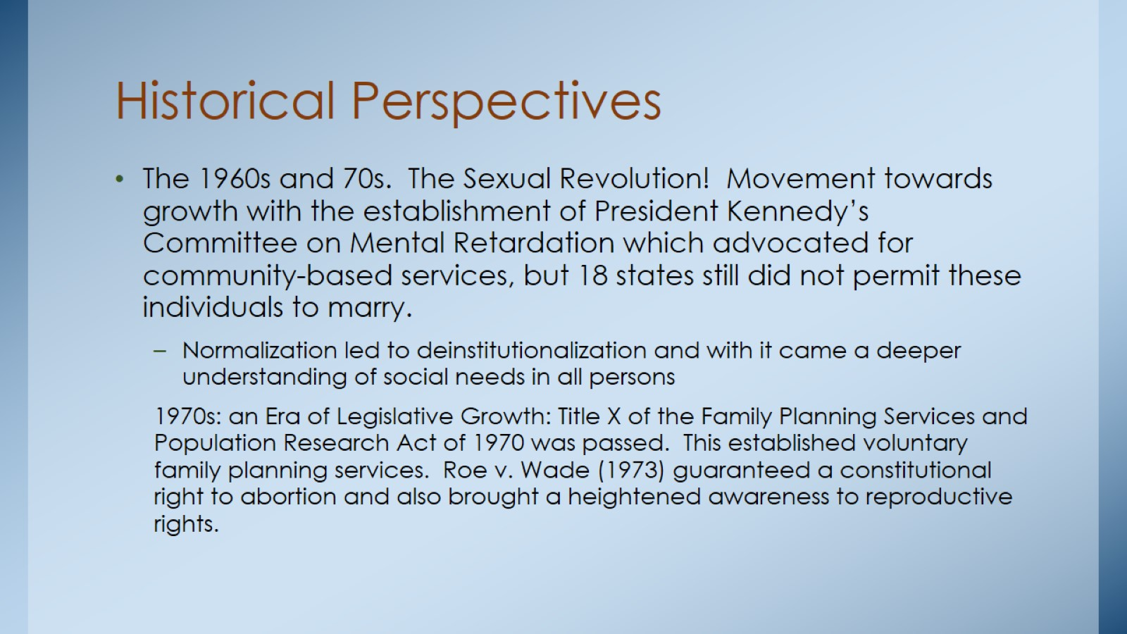
Historical Perspectives

Slide 8
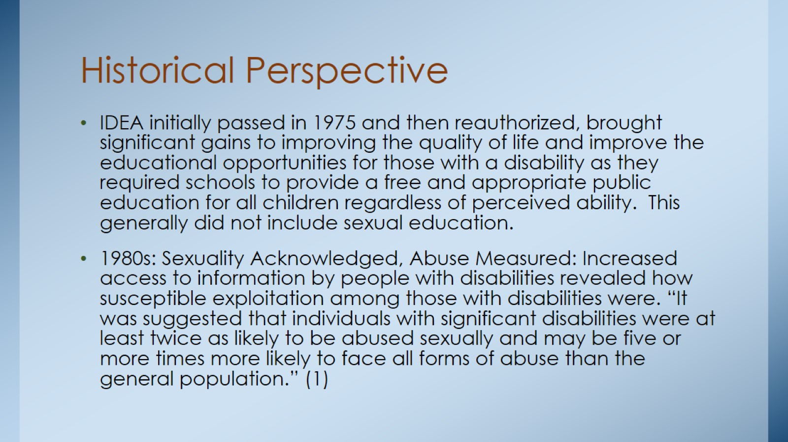
Historical Perspective

Slide 9
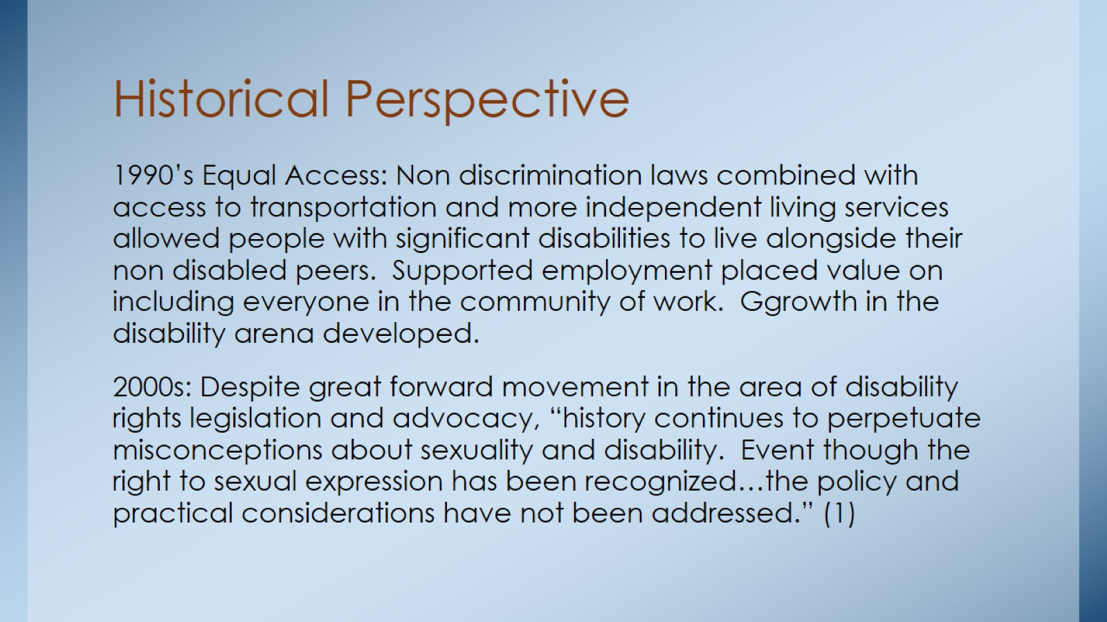
Historical Perspective

Slide 10
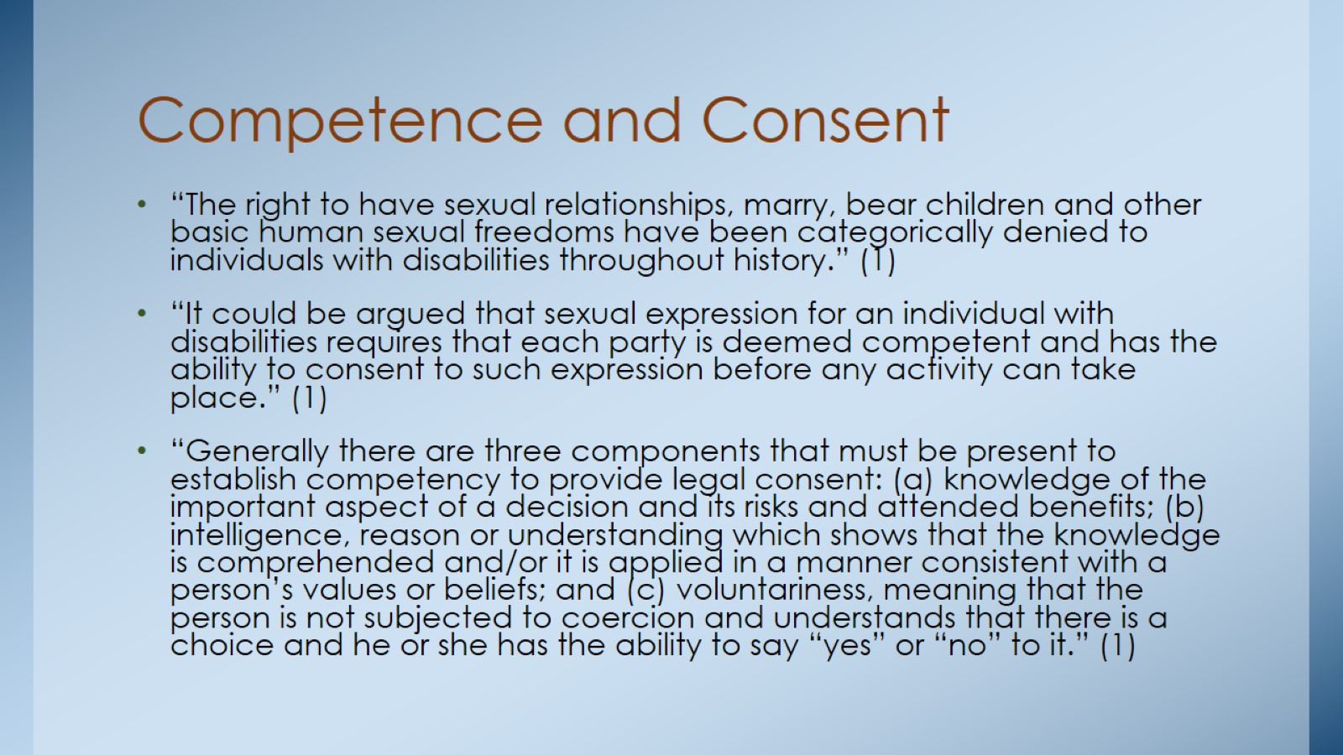
Competence and Consent

Slide 11
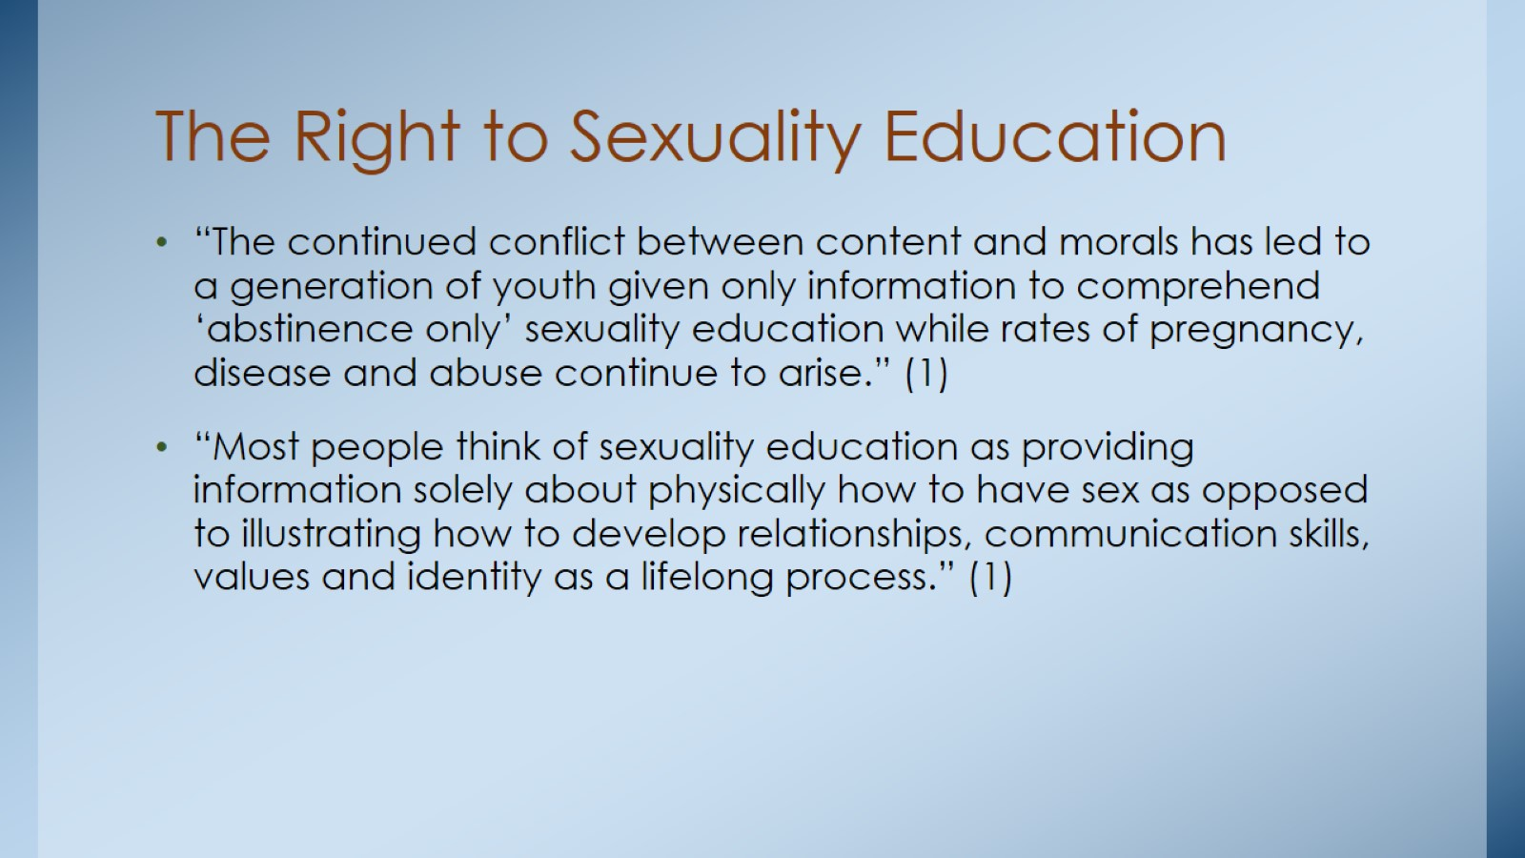
The Right to Sexuality Education

Slide 12
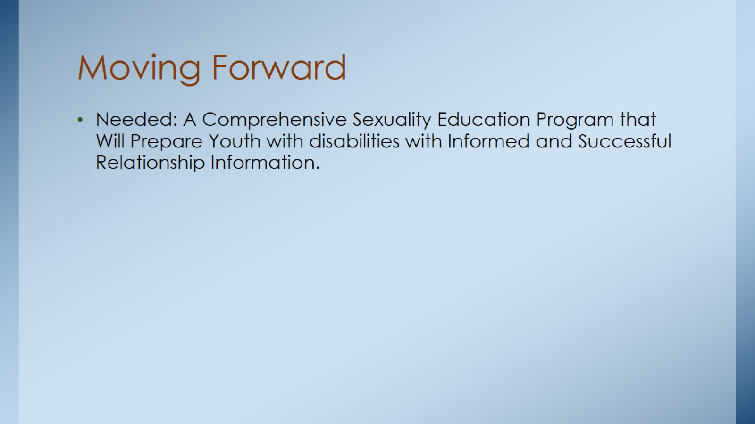
Moving Forward

Slide 13
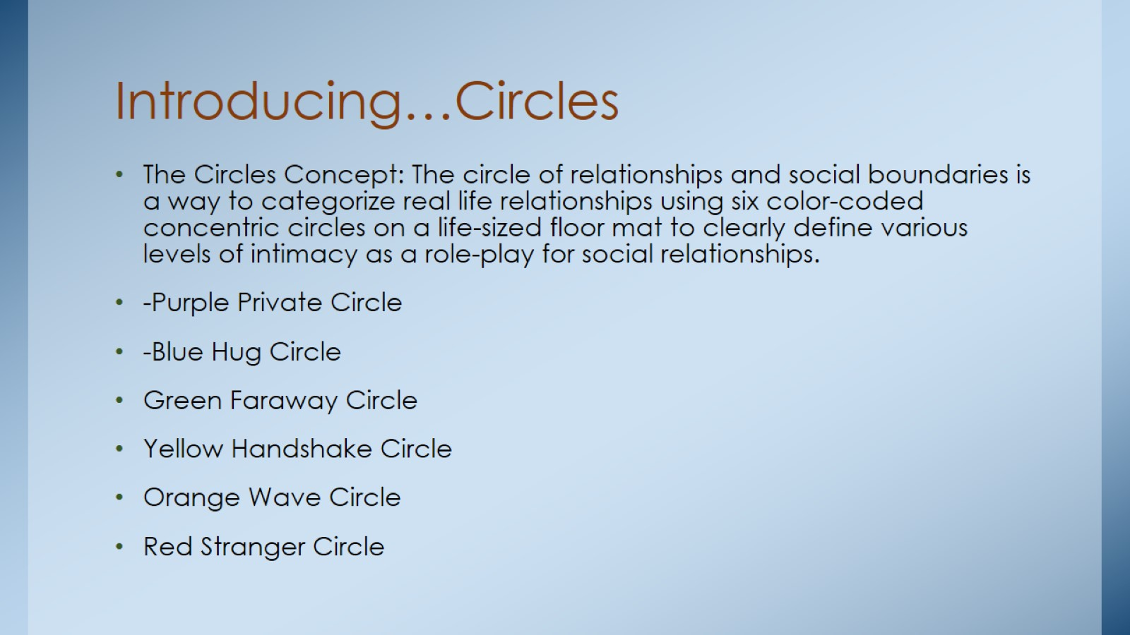
Introducing…Circles

Slide 14
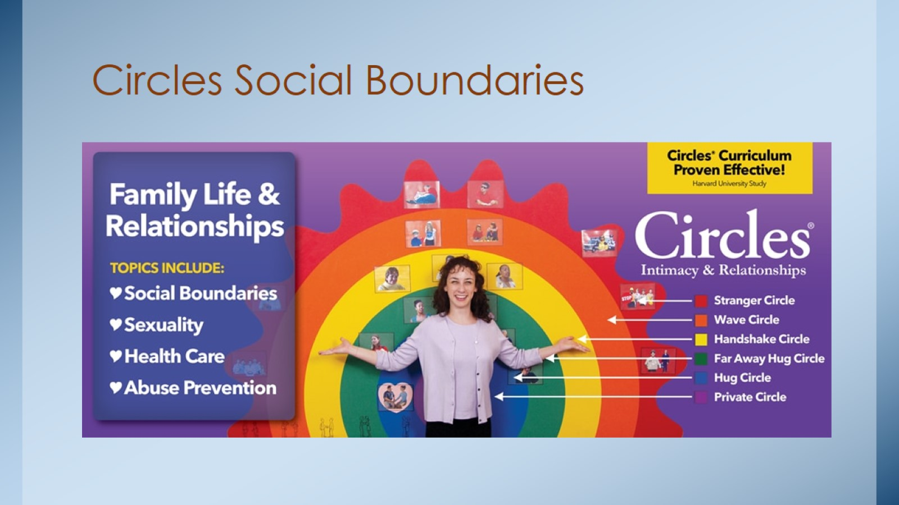
Circles Social Boundaries

Slide 15
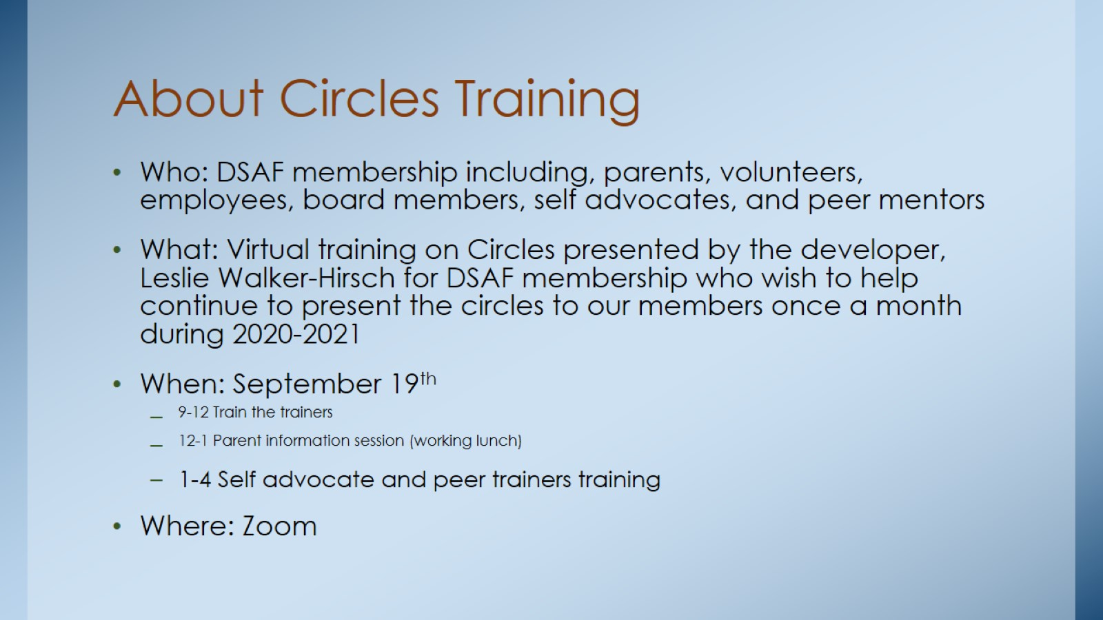
About Circles Training

Slide 16
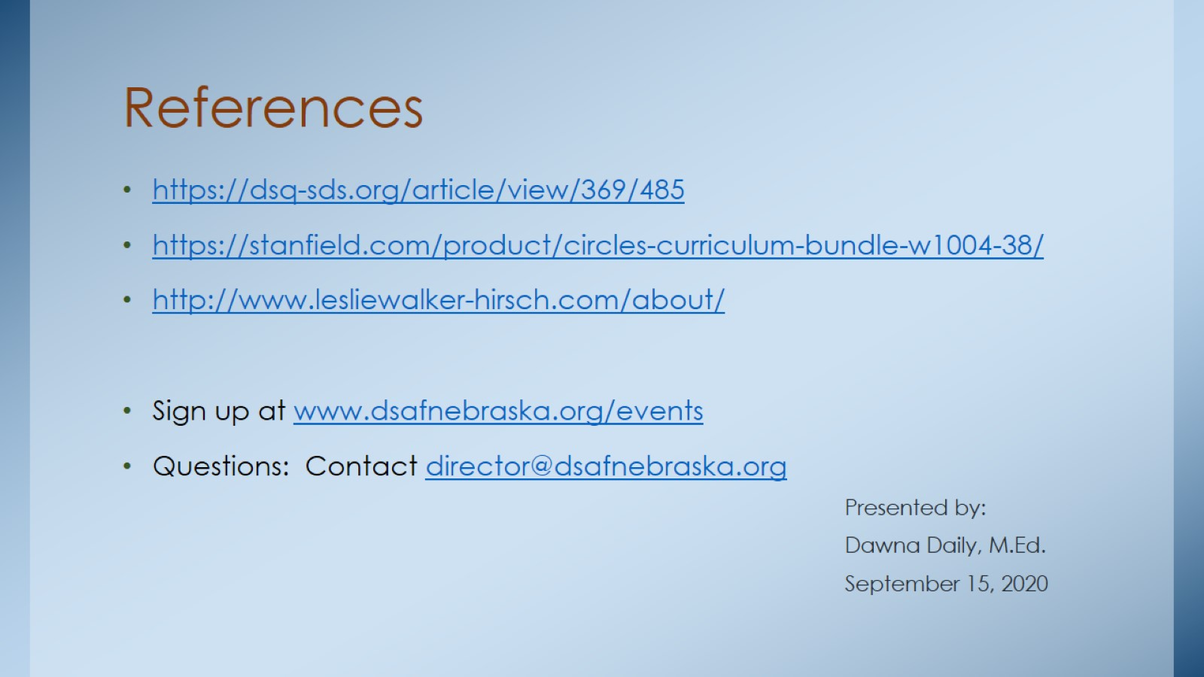
References

