Slide 1
Let’s Talk About Independence!
And Steps to Achieving It
Material shared today is taken from PTI Nebraska, FEAT curriculum, ODEP, PACER Center
and experience….LOTS of experience!
Notes:
Material shared today is taken from FEAT curriculum, ODEP as well as the PACER Center.

Slide 2
PTI Nebraska
a statewide resource for families of children with disabilities or special healthcare needs
provides training, information and support to parents who have a child/children receiving early intervention, special education or healthcare services
serves families of children with special needs/healthcare needs age birth through 26 anywhere in the State of Nebraska
a non-profit organization funded by the Federal Department of Education (OSEP) and the Nebraska Department of Education (NDE)

Slide 3
PTI Nebraska staff are parent-professionals
PTI is available to talk to parents and professionals by phone, e-mail or in- person
Areas of focus and expertise include
      early intervention
      special education
      healthcare services
      transition
      disability specific information
      community resources

Slide 4
Services provided by PTI Nebraska are FREE
Phone consultations
Attending IEP meetings for support
Workshops
Webinars
Podcasts
All information is confidential
NO COST!

Slide 5
PTI RESOURCES for Going Back to School:
7/2020 PTI webinar “Amy Rhone, Administrator of the Office of Special Education at Nebraska Department of Education (NDE)”
  https://www.pti-nebraska.org/amy-rhone/
8/2020 PTI webinar “IEP in the Midst of a Pandemic”
  https://www.pti-nebraska.org/iep-tips-in-a-pandemic/
NDE website with information about reopening schools is LAUNCH NEBRAKSA
  https://www.launchne.com/wp-content/uploads/2020/05/SPEDGuidanceFinal2020.pdf

Slide 6
Record Keeping Tools During COVID-19
Log sheet to keep track of your child’s goal progress. It’s important to know where your child was performing on their IEP goals when schools closed in March 2020 and where your child is performing right now/when school starts in the fall
https://www.pti-nebraska.org/goals-tracking-sheet/
Log sheet to track your child’s supports and services that they received or did not receive during the time school are closed due to the pandemic
https://www.pti-nebraska.org/covid-19-closure-log-sheets/

Slide 7

October - National Disability Employment Awareness Month
Notes:
Why does disability employment awareness need its own month?? (next slide)

Slide 8
Why is work important?
  Independent living
  Economic self-sufficiency
  Community participation
  Income and benefits
  Confidence and sense of belonging in the community
  Social relationships
  Pride
  A role in the adult world
  Quality of life!
Notes:
WORK provides equal opportunities, increases independent living, economic self-sufficiency, community participation and quality of life. Work provides real life experiences, fosters independence and promotes pride.

Slide 9

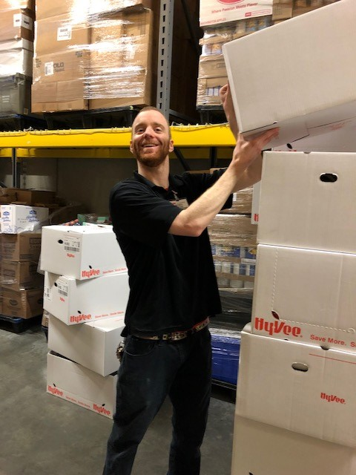
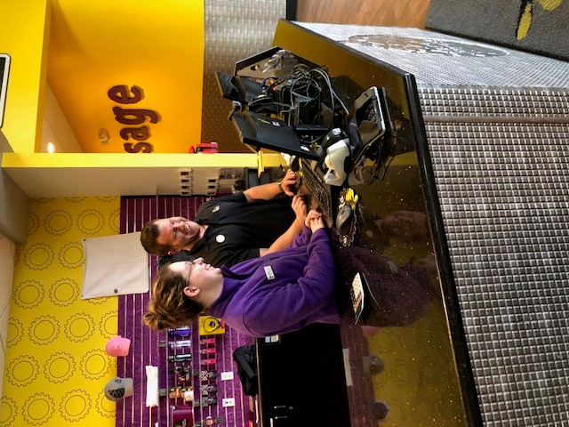
Work is part of LIFE!

Slide 10
Preparing for Independence: ACTION STEPS
Family’s role is crucial in preparing your young adult for independence
  Participate in process – get involved!!
  Model work expectations
  Mentor
  Network
Notes:
TITLE PAGE – will be reviewing these action steps during this webinar (Holly, don’t spend a lot of time talking about them now…)

Slide 11
Preparing for Independence: ACTION STEPS!
  Get involved!
    Participate in the IEP process
    Pre-employment Transition Services begins at 14
    Transition Planning in the IEP begins at 16
    Encourage interests

Slide 12
IEP and the Transition Plan
Transition planning required starting at age 16 in Nebraska
Uses transition assessments to develop measurable post-secondary goals in the following areas:
    Employment
    Education/Training
    Independent living skills (when appropriate)
Includes needed and appropriate services (including employment services)
Identifies interagency responsibilities

Slide 13
IEP Planning Process
Transition plan should guide the IEP development
Begin with the end in mind – should be a “results-oriented” process "focused on improving the academic and functional achievement of the child”
Be a coordinated set of services
Include representatives from community-based adult service agencies
Include partnerships with community members, businesses, and organizations of relevance to planning and goals
Notes:
Planning for transition to outside of the school walls

Slide 14
Quality Assessment = Quality IEPs =
Better Outcomes for Students
In order to improve student post-school outcomes, begin with the end in mind.
Letting the student’s post-secondary goal drive the entire IEP is one way to begin with the end in mind.
Teachers should conduct assessments with students 1-1.
Comprehensive transition assessment tools need to be used first, then given time to gather data & determine which informal assessment need to be completed.
“Whaddya wanna be when you grow up?” interview that tends to occur 30 minutes prior to the IEP meeting is not an assessment, nor is it effective.
**Parents can and should provide input to the IEP’s Transition Plan**

Slide 15
Notes:
Tools parents can use in order to contribute to the IEP and Transition Plan – do your own assessment!! i.e. Greatness Planning – something simple, conversation topics for car rides or dinner time!

Slide 16
Notes:
NDE Transition Guide is a tool parents can use during IEP meetings to help gauge their child’s participation and progress on Pre-ETS activities.

Slide 17
Activity
Discovering Passion (Parents\Families)

Slide 18
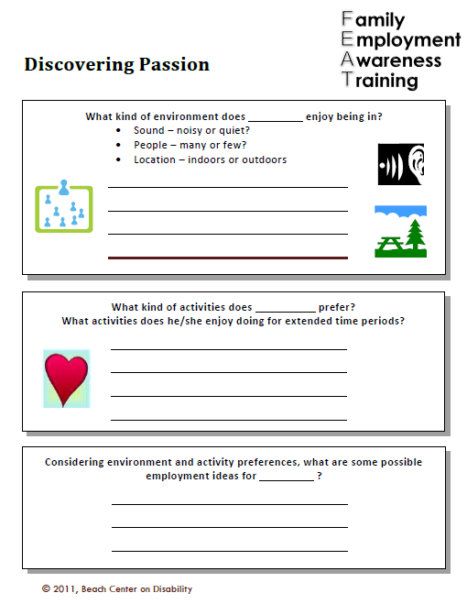
Notes:
we encourage participants to work in pairs or small groups. We also share out ideas whole group

Slide 19
Post-secondary/Transition IEP
Examples of Activities to include in IEP:
Attend Eastern Nebraska Transition Conference
Take a Community Based Learning class
Visit the Student Services office at local college
Attend the Project SEARCH Job Fair
Complete a 1 day job shadow of ______ (insert career interest)
Take pre-ACT
Meet monthly with Nebraska VR counselor
Lead my own IEP
Participate in mock interview through Career Exploration Class
Notes:
NDE Transition Guide

Slide 20
Preparing for Independence: ACTION STEPS
    Model work expectations
      Practice “soft skills” at home
      Assign responsibilities and hold accountable
      Maintain high expectations
    Mentor
      Use volunteer experiences to build work skills and resume
      Try several experiences so youth can explore different types of job
    Network
      Relationships, not want ads, provide the most job opportunities
      Everyone has a network within their community they can use
      How did you find your first job?
Notes:
Soft skills examples – communication, time management, problem solving, team player, ability to accept corrective criticism, positive attitude

Slide 21
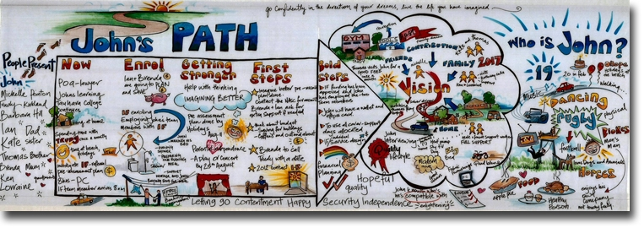
Building a Support Network
Inviting people to become a support
Person-centered planning
  PATH - Planning Alternative Tomorrows with Hope
  MAPS - Making Action Plans
  GAP - Group Action Planning
http://www.imaginebetter.co.nz/planning
Notes:
PERSON-CENTERED PLANNING crucial

Slide 22
How Families Contribute to the Employment Process
Look for the individual’s skills and passions
Assist with brainstorming business/job ideas
Encourage creativity
Plan for employment through IEP transition goals
Network
Share job contacts
Inform the job coach of any problems or issues
Participate in problem solving
Monitor service delivery and quality

Slide 23
Family Activity – Inviting Support
Who are the people in your life?
Who are the people who have helped?
Who are the people who have information?
Who are the people with whom you want to connect?

Slide 24
Notes:
Inviting support activity

Slide 25
Preparing for Employment: OPTIONS
Employment comes in a variety of “shapes and sizes”
Think “outside the box”
Everyone has a “starter” job
Volunteering counts!
Take advantage of work-based learning opportunities through school or Workforce Development

Slide 26
Employment Possibilities
Integrated Competitive Employment
Supported and Customized Employment
    Created Jobs
    Carved Jobs
    Resource Ownership
    Self-Employment
    Business Within a Business
    Self-Employment
    Employer-Initiated Models
Notes:
FEAT workshop provides more in depth discussion about the variety of employment possibilities

Slide 27



Integrated Competitive Employment
Real work in real businesses
20 hours a week or more
Minimum wage or higher
Individualized supports
Notes:
Examples from Nebraska: Peter, Jon, Katie

Slide 28
Supported and Customized Employment
Supported Employment
Customized Employment
Real work
Integrated businesses
Assistance from job coach
On-going support services
Job match
  (Rehabilitation Act, 1973)
Real work
Integrated businesses
Assistance from job coach
On-going support services
Negotiation between needs of employer and individual
One person at a time, one employer at a time
(Office of Disability Employment Policy)

Slide 29
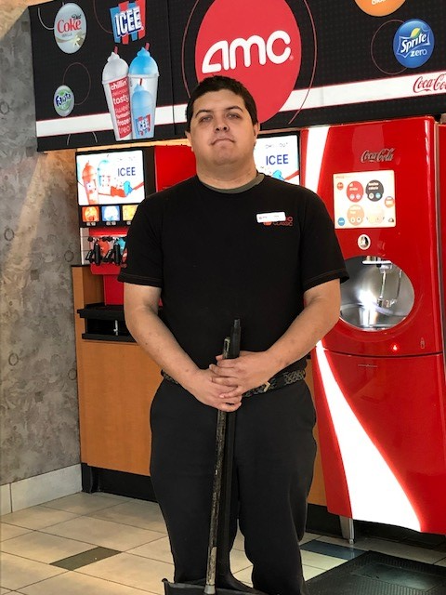
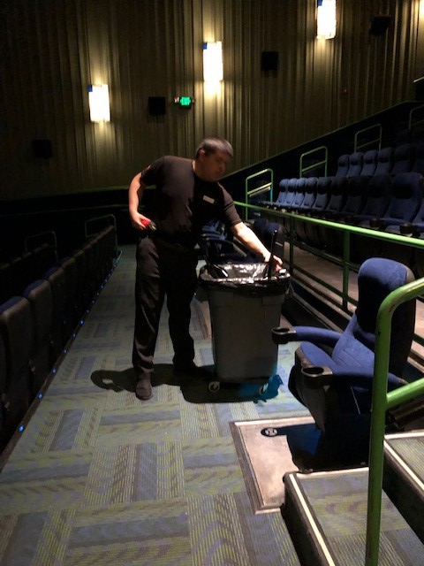
Meet Chris
Chris’ story was gathered by PTI Nebraska in 2019.

Slide 30
Meet Chris
Chris has worked at AMC Theaters for 5 years
  Cleans theaters, stocks/sweeps restrooms, cleans common areas
  Cross trained on other job duties such as food prep, ticket taking
  Has gained confidence and communication skills while reporting work progress to on-site manager or job coach, and answering theater customers’ questions
Supports provided include
  Receiving DD Waiver services
    Job Coach
    Service Coordination/case management
    Transportation to/from work, to/from grocery store
    Residential provides social support
  Receiving SSI and SSDI
Natural Supports
  Theater management provides supports and task training
  Written/visual checklist of job duties
  Walkie Talkie communication, same as all employees

Slide 31
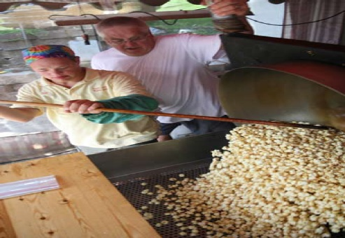
Self-Employment
Become a small business owner and operator
  Come up with a business idea
  Develop a business plan
  Obtain start-up funds
  Arrange supports
Freedom to make own choices
Be more independent
Decide the work you want to do
Choose your work hours
Choose where you want to work
Choose who to work with or for
Choose what jobs to take or not take
Build self-confidence/self-esteem
Increase economic self-sufficiency

Slide 32
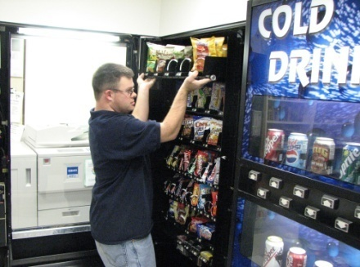
Self-Employment – Meet Ryan
Very social and independent
Previous volunteer and work experience in high school at a local plant nursery, Burger King, and Arby’s
Ryan’s GAP (group action planning) team gathered to plan for his future
  Used MAPS planning process to determine possible jobs and made a plan
  Suggested a Kansas Council on Developmental Disabilities small business ownership grant
Owns 18 vending machines placed at local businesses
  Empties money, refills change, and makes deposits
  Fills machines with snacks and sodas
  Takes inventory and purchases needed items
  Works 15-18 hours/week and earns a weekly paycheck
Ryan’s story was gathered by the Beach Center on Disability in Lawrence in 2010.

Slide 33

Business Within a Business –
Meet Tamara
Desired choice and control in her life
Vocational Rehabilitation initially evaluated
Tamara and determined her “unemployable”
  Mom challenged the evaluation
  Tamara’s planning team decided to explore self-employment
Owns and runs a hotdog stand at a county justice center
  Family explored various business ideas, including start-up costs and operations of each
  Located a community building that had a cafeteria and no food service and set up shop there
  Initially only offered hotdogs – has since expanded to include salads, soups, sandwiches, and cookies
Tam’s story adapted from Sowers, J., et al. (2001). Self-Directed Employment: Story Book of Oregonians with Developmental Disabilities.
Developed by the Center on Self-Determination, Oregon Institute on Disability and Development, and Oregon Health & Science University.

Slide 34
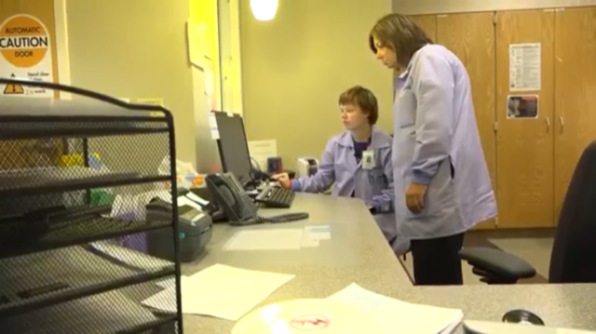
Employer-Initiated Employment Model: Project SEARCH
Started at Cincinnati Children’s Hospital in 1996
Business led partnership
Students transitioning from school to work
  On site classroom instruction
  Worksite rotations
  Lunch with peers
  Feedback from instructors
  Individualized job development
  Job placement
Project Search runs during school year
  Full day program
  One hour classroom time both AM and PM
  Three 10-12 week unpaid internships throughout the host site
  At the end of the internships, identify best fit and apply for permanent employment
Notes:
Nebraska – partnership between Neb VR, a business, area school systems, Commission for the Blind & Visually Impaired, ATP, and DD. For 2018-2019 school year, 16 Project Search sites throughout Nebraska. Globally, 20% of Project Search participants hired at host site.

Slide 35
Project SEARCH
Nebraska Project Search Student sites:
  Bellevue – Bellevue Medical Center (Bellevue)
  Columbus – Columbus Community Hospital (ESU7)
  Grand Island – St. Francis Medical Center (GI Public)
  Hastings – Mary Lanning Health Care ( Hastings and ESU 9 schools)
  Kearney – Good Samaritan Medical Center (Kearney)
  LaVista – Embassy Suites (Papillion/LaVista)
  Lincoln – Embassy Suites (Lincoln)
  Lincoln – Cornhusker Marriott (Waverly, Norris, Crete, Malcolm, Syracuse, Wahoo and surrounding districts)
  Norfolk – Faith Regional Health Services (Norfolk, Wayne, surrounding area)
Notes:
Nebraska – Embassy Suites LaVista - 6th year as Project Search site. First class, Embassy Suites hired 3 of the 4 students. As of January 2019, 15 of 24 Project Search participants hired by Embassy Suites are still employed (63%). Hotel industry typically has 50% turnover rate. 9:45 video https://www.youtube.com/watch?v=JlFn8jFHuiA#t=35

Slide 36
Project SEARCH
  North Platte – Wal-Mart Distribution Center (NP Public)
  Omaha – Children’s Hospital (Westside)
  Omaha – Heritage at Sterling Ridge (Millard)
  Omaha – UNMC Main Campus (Madonna School/OPS)
  Omaha – Madonna Rehabilitation Center (Elkhorn)
  S. Sioux – Mercy Medical Center ( Omaha Nation, Winnebago, South Sioux City, Homer)
  York – York General Hospital (Wilbur, Clytonia, Utica-Centennial, York, McCool Junction, Heartland, ESU 6)
Nebraska Project Search Adult site:
  Omaha – UNMC (56 different rotation opportunities)
Notes:
Nebraska – partnership between Neb VR, a business, area school systems, Commission for the Blind & Visually Impaired, ATP, and DD. For 2018-2019 school year, 16 Project Search sites throughout Nebraska.

Slide 37
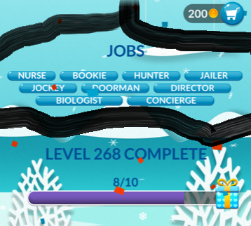
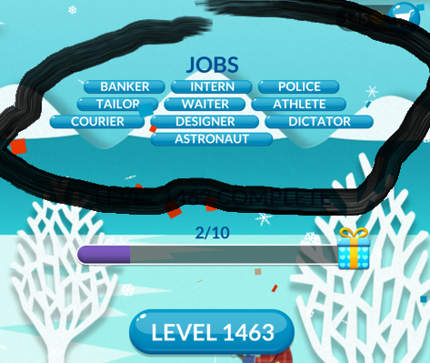
Preparing for Employment: OPTIONS
Notes:
Word Stacks…job examples…think outside the box! Be a bookie! Be a dictator!!

Slide 38
Preparing for Employment: RESOURCES
Nebraska Vocational Rehabilitation Services
Benefits planning
Assistive Technology Partnership (ATP)
Education & Training Options
PTI Nebraska

Slide 39
Vocational Rehabilitation (VR)
Pre-Employment Transition Services (Pre-ETS)
  Pre-ETS serves 14-21 year old youth
  VR counselor is assigned to each high school in Nebraska
  Monthly meetings as a class or one-on-one with youth
  Activities focus on 5 pre-employment transition areas:
    Job Exploration Counseling
    Work-Based Learning Experiences
    Counseling on Post-Secondary Training Opportunities
    Workplace Readiness Training
    Instruction in Self-Advocacy
  http://www.vr.nebraska.gov/students/tsp.html

Slide 40
Benefits Specialist
May also be called a “benefits planner” or a “benefits counselor”
Helps you understand
  eligibility
  impact of work on benefits
  how to use work incentives
Ideal to meet before starting work
  Social Security (800-772-1213)
  Goodwill of Greater Nebraska (402-563-1194 Columbus office)
  Easterseals of Nebraska (800-650-9880)

Slide 41
Work Incentives
1619(b)
Impairment Related Work Expenses (IRWE)
Plan for Achieving Self-Support (PASS)
Ticket to Work

Slide 42
Work Incentives
Blind Work Expenses
  Any expense needed to earn income (not necessarily related to disability) can be excluded
Student Earned Income Exclusion
  If under age 22, may exclude up to $1,900 (for 2020) in earnings per month
  Maximum annual exclusion of $7,670 (for 2020)

Slide 43
Assistive Technology (AT)
Items, equipment, or systems used to increase, improve, or maintain the capabilities of people with disabilities
Low-tech items – like an adjustable desk, penholders, or cup holders
High-tech items – like switches, voice output communication devices, or specially designed robotics
Assistive Technology Partnership (ATP) is under Nebraska VR. https://atp.nebraska.gov/about/index
  AT specialists can help set up accommodations, talk to employers, teach how to use equipment, find best solution
  Nebraska’s Loan Program – try it before you buy it https://www.at4all.com/
  Nebraska’s Reuse Network – keep equipment out of landfills and use with people who need it
  Private AT specialists available such as Assistology https://assistologyomaha.com/
  Job coach may or may not have expertise
Notes:
Nebraska has LOAN program, try it before you buy it. AT4ALL, Assistive Technology Partnership (ATP- VR)

Slide 44
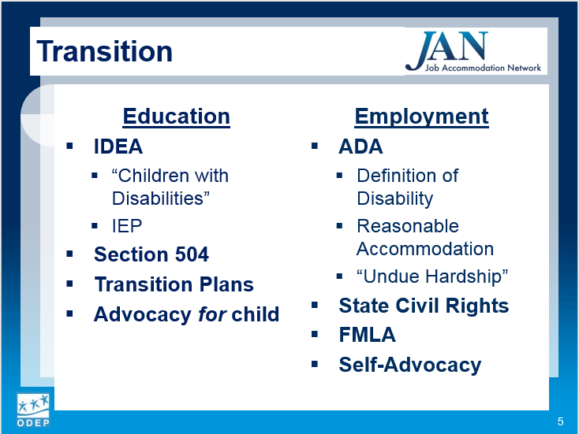
Used with permission from AskJAN 2017 webinar “Transitions”
https://askjan.org/events/index.cfm?calview=eventdetails&dtid=D77DF428-9F7F-C7DF-23405858824CF1EA

Slide 45
Education and Training Options
On-the-job training
Technical training
Apprenticeship programs
Job Corps
Public or private universities or colleges
Community colleges
Think College programs
  LifeLink Nebraska (Scottsbluff) https://thinkcollege.net/programs/lifelink-nebraska
  University of Nebraska Omaha (UNO) *NEW* Fall 2019!
Nebraska Transition College (NTC)
  NTC classes through Southeast Community College, Lincoln *NEW* Spring 2019 https://www.nebraskatransitioncollege.org/
Notes:
WINAHEAD

Slide 46
Postsecondary Accommodations
Important things to remember if enrolling in college courses:
Colleges do not have to provide the same accommodations as the student received in high school;
A student has to register as a student with a disability. This is done through the college’s disability service office;
A student does not have to identify that they are a student with a disability during the enrollment process;
A student will need to provide documentation of their disability (i.e. Multidisciplinary Team report from high school, disability statement from a medical provider, IEP, etc.);
Each college may require different documentation of disability;
A student does not get a “case manager” in college, but a Disability Service Dept. staff member who can help determine accommodations and develop a plan

Slide 47
Postsecondary Accommodations
A written accommodation plan will be developed for the student and the student is responsible to provide that to their instructors;
Different colleges have different levels of support for a student;
Parents are not entitled to the accommodation plan or monitor the student’s progress;
Students are not entitled to updates testing if necessary.
Disability Programs in College:
Southeast Community College in Lincoln-Nebraska Transition Program
Southeast Community College system-Trio Program to support student’s with disabilities, first generation college students, or students who are low-income or at risk populations.
List of Disability Service Offices for Western Iowa & Nebraska Colleges and Universities can be found at http://ahead.org/affiliates/wester-iowa-and-nebraska

Slide 48

Parent Training Information (PTI)
PTI Nebraska
  PTI website: http://pti-nebraska.org/
  Holly’s Email: hschwietz@pti-nebraska.org
  call PTI Nebraska Toll Free: (800) 284-8520

Slide 49

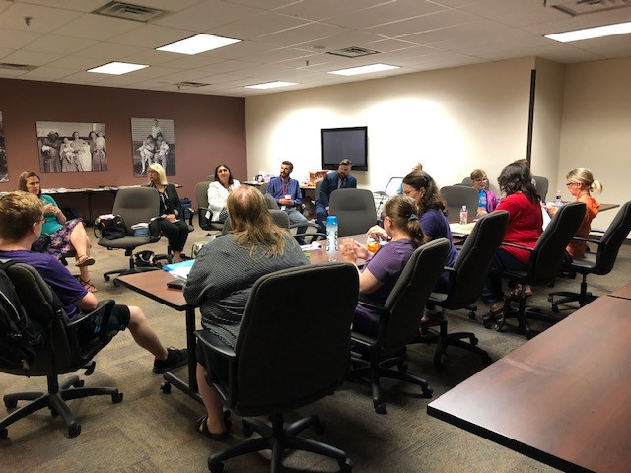
Upcoming FEAT Workshops will be available soon!

Slide 50
Family Employment Awareness Training FEAT
Mission
Key Principles
To increase the expectations and awareness of families and individuals with disabilities regarding the possibilities for the member with a disability to obtain meaningful and satisfying work in the family’s community.
Everyone with a disability can work when provided with the appropriate supports and services.
Everyone with a disability can have a job that is both enjoyable and satisfying.
Everyone with a disability can make more money working than by relying on public benefits alone.
© 2012, 2017, 2019 Beach Center on Disability, University of Kansas
.

Slide 51

Identifying Resources Activity
Activity
Considering the employment possibilities for your child,
  What support needs may he/she have on the job?
  What resources can be used to address those needs?

Slide 52
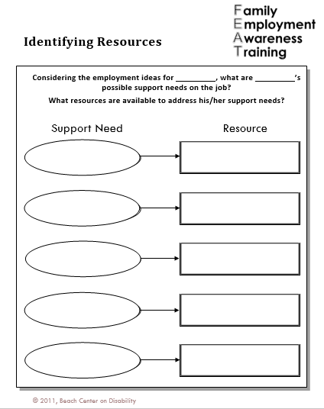

Slide 53
Nebraska Department of Health & Human Services - Division of Developmental Disabilities (DD)
Point of entry for developmental disabilities services, while working with Vocational Rehabilitation.
Determine eligibility for services
Assigned Service Coordinator who provides case management
Can refer you to other service providers
May offer supported employment services
http://dhhs.ne.gov/Pages/DD-Service-Array.aspx (NEW! 4/2019)
http://dhhs.ne.gov/Pages/DD-Participants-and-Families.aspx (NEW! 4/2019)
Notes:
http://dhhs.ne.gov/Pages/Developmental-Disabilities.aspx

Slide 54
Community Rehabilitation Providers (CRP)
Organization or agency that provides vocational rehabilitation services
May be within public network (i.e. VR or DD affiliate) or private service agency provider
Services may include:
  assessment for determining eligibility and vocational rehabilitation needs
  job development, placement, and retention services
  supported employment services and extended services

Slide 55
Nebraska Medicaid
Home and Community Based Services (HCBS) Waivers
Residential/Personal Assistance Services for work
Medicaid Insurance for Workers with Disabilities (MIWD)
http://dhhs.ne.gov/Pages/DD-Regulations-and-Waivers.aspx

Slide 56
Home and Community Based Services Waiver (HCBS)
Is alternative to institutional care
Typically has waiting list
  Services dependent upon availability of funds
Funds community services (e.g., supported employment, day services, residential)
Common source of funding for ongoing job support following exhaustion of VR services
May be able to self/participant-direct some or all services
http://dhhs.ne.gov/DD%20Documents/Info%20Sheet%20for%20HCBS%20Waivers.pdf
Notes:
http://dhhs.ne.gov/DD%20Documents/Info%20Sheet%20for%20HCBS%20Waivers.pdf

Slide 57
Residential/ Personal Assistance Services
Typically residential services used for chronic conditions
  self-care, dressing and grooming, bathing and personal hygiene, mobility and transferring, and housekeeping activities
Personal assistance services can be used for work related needs of consumers
  if you work at least 40 hours a month and you are paid at least minimum wage
Consumers may choose self-directed services or have agency-directed services

Slide 58
Transportation
Can use work incentives to pay for transportation – Impairment Related Work Expenses (IRWE) will cover half the costs (or all if blind)
Transportation Options:
  Public transportation - bus, para-transit, MOBY, taxi, Uber, Lyft
  Centers for Independent Living (CILs)
  Car-pooling with a co-worker – sharing gas
  Friends or family
  Driver assessment and training
  Volunteer drivers (e.g., Retired and Senior Volunteer Program, churches)

Slide 59
Planning for Tomorrow: Set Your Child up for SUCCESS!
Big Picture Outcomes for Independence
Take Action
Explore Options
Take advantage of resources!
What is your action plan?
  Next steps for this school year

Slide 60
Preparing for Independence: NOW!
    Be involved!
      Discuss long-term plans with your child
      Participate in IEP and Transition Planning process
      Identify strengths
    Be part of the team!
      Network
      Get input from family, friends, neighbors, teachers, people who have known your young adult in a variety of situations
    Be proactive!
      Locate birth certificate and social security card
      Get State ID (photo ID)

Slide 61
Thank you!
Questions?
Comments

